Slide 1
Medical Student Scholars Program (MSSP)
Amy Guiot, MD, MEd
Director, MSSP
Director, Phase 3
Gina Burg
Program Director, UCCOM - Office of Medical Education
Medical Student Scholars Program
M3/4 Curriculum Support

Slide 2
Medical Student Scholars Program (MSSP)
PURPOSE:
To provide highly motivated students with a unique opportunity to explore a medical specialty in depth throughout their four years of medical school with a summer research experience culminating in publication and/or presentation.

Slide 3
2024 Match Data by MSSP
Cardiovascular Medicine – 1 Med-Peds
Child and Adolescent Health – 7 peds, 4 med-peds, 1 ped PM&R,
2 urology, 2 EM,1 FM, 1 pathology, 1 prelim year/anesthesia
Emergency Medicine – 2 EM
Family Medicine – 2 FM
Geriatric Medicine – 3 IM, 2 FM, 1 Med-Peds, 1 OB/GYN
Psychiatric Behavioral Neuroscience –1 psych, 1 plastics
Nephrology – 1 IM
Neuroscience – 2 EM, 2 IM, 1 FM,1 urology, 3 neurology,
1 peds-neuro, 2 neurosurgery, 2 psych, 1 OB/GYN,
1 prelim surgery
Women’s Health – 1 OB/GYN, 1 med-peds, 2 FM

Slide 4
MSSP Outcomes
Engage in mentored and preceptor-supervised educational experiences to expand fund of knowledge and skill set within a circumscribed area of interest longitudinally across all Phases 1-3
Partake in clinical and didactic activities
Participate in scholarly research project
Present and publish scholarly work
Achieve designated MSSP Scholar at Honors Day (Graduation)

Slide 5
MSSP Tracks
Anesthesiology
Cardiovascular medicine
Child and adolescent health
Emergency medicine
Family Medicine
Geriatric health
Integrative Health and Medicine
Infectious Disease
Medical Education
Nephrology
Neuroscience
Ophthalmology
Orthopedic Surgery
Psychiatry-behavioral neuroscience
Pulmonary
Women’s health
Summaries of each track can be found here: Medical Student Scholars Program

Slide 6
Min MSSP Requirements over 4 yrs
Didactic – 15 hours
  Lectures/ conferences
  Journal club
  Specialty interest group meeting
  MSSP group meetings
  Other
Clinical
  Shadowing/Experiential Opportunities – 10 hours
  M3 specialty elective if applicable
  M4 Elective
Scholarship – approx. 200 hours
  M1/2 Summer Scholarly Project
  Presentation of project at UCCOM Fall Research Symposium or other to include on CV
  Research 101 course
Service / Leadership – 8 hours
  Volunteer
  Committee Member
  Leadership roles
Mentorship

Slide 7
M1/Phase 1 Minimum Requirements
  Strive to participate in two “activities” per month averaged over a six month time period – any combination of above didactic, clinical, shadowing/experiential, service/leadership
  Meet a minimum of one time over the course of year one with mentor
  Complete the online course Research 101 prior to starting the summer research project

Slide 8
Summer Research between M1 and M2
  Research opportunity during the summer between M1 and M2
  Minimum of 200 student work hours for research project
  Culminate in a final project and at minimum be entered in the M2 Fall November Research and Service Symposium or other means for presenting/publishing for CV
  Students should strive to present at local, regional, or national conferences.
  Students should strive to publish.

Slide 9
M2/Phase 2 Minimum Requirements
  Strive to participate in two “activities” per month averaged over a six month time period – any combination of above didactic, clinical, shadowing, service/leadership.
  Meet a minimum of one time over the course of year one with their mentor

Slide 10
M3/Phase 2 Requirements
May request but not require student to participate in a specialty two-week elective during M3 (EM, Geriatrics)
Students will be given priority to the specialty elective.
Continue mentoring at least twice/year for research and planning of M4 or residency

Slide 11
M4/Phase 3 Requirements
Complete minimum of two week with most MSSPs requiring four-week clinical elective work in an area related to the specialty track
  Discuss with MSSP director
Students will be given priority to the elective

Slide 12
MSTP Students
May apply to an MSSP
Reach out to Dr. Ellis to discuss summer research commitment of MSSP with MSTP requirements

Slide 13
MSSP Honors Notations
Students who successfully complete all MSSP requirements will have the MSSP distinction mentioned during the award of their medical degree at the College of Medicine’s Honors Day ceremony
Students may comment in the noteworthy characteristic on the MSPE of their success with the MSSP
Students may utilize the honors section of the ERAS application to share their MSSP experience

Slide 14
Financial Support
Sponsoring departments are encouraged, but not required, to provide financial support for students participating in the summer component of their track.
  Range to date $ 800 - $5000

Slide 15
Academic Expectations
  Maintain good academic and professional standing to move on from year to year in the MSSP.
  In the event that a student participating in the MSSP experiences academic difficulty at any time, consideration of withdrawal will be discussed with the MSSP director, student, and possibly advisor in the office of student affairs.

Slide 16
Enrollment
Variable number of students selected for each track
Students are selected by Jan 1 of M1 with clinical activities and mentoring spanning all 4 years and research during M1/M2 summer.
Students will be required to log all MSSP “activities” in MedOneStop

Slide 17
MSSP Class of 2027
MSSP | Accepted M1 2023
Anesthesia | 2
Cardiovascular Medicine | 1
Child and Adolescent Health | 18
Emergency Medicine | 3
Family Medicine | 8
Geriatric Medicine | 8
Infectious Disease | 2
Integrative and Lifestyle Medicine | 3
Medical Education | 2 (2026)
Mental Health – Psychiatric Behavioral Neuroscience | 4
Nephrology | 2
Neuroscience | 9
Ophthalmology Surgery | 2
Orthopaedic Surgery | 2
Pulmonary | 1
Women's Health | 6
TOTAL | 79 (+/-)

Slide 18
Chat with current M4 students enrolled in MSSP

Slide 19
Selection Process
Students apply via MedOneStop
  Application opens August 14th
  Submission deadline date October 4th
  Decision date before/by January 1
Applicants can apply to two programs marking first and second choice
Applications are reviewed by individual MSSP departments to determine which candidates to accept
Applicants are interviewed by MSSP director

Slide 20
Application
Very simple
After August 14th, Go to MedOneStop where majority/all of medical student information housed
Click on extracurricular tab
Click on MSSP Application/Tracking
Click on Apply Now and all contact information is automatically uploaded

Slide 21
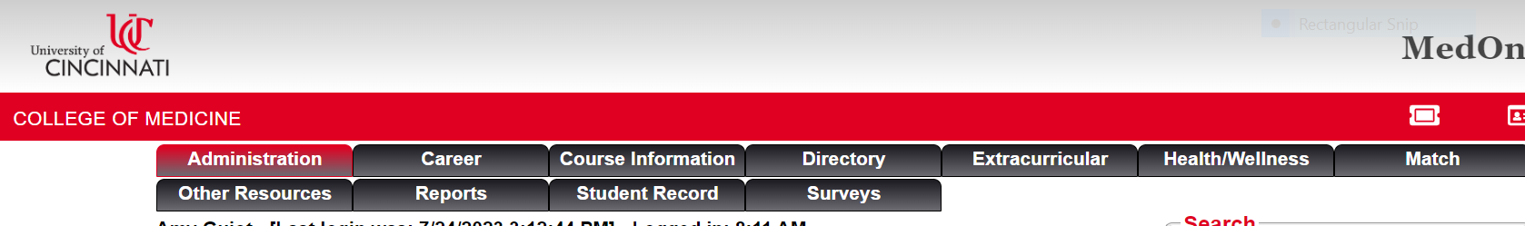
Click on extracurricular tab

Slide 22
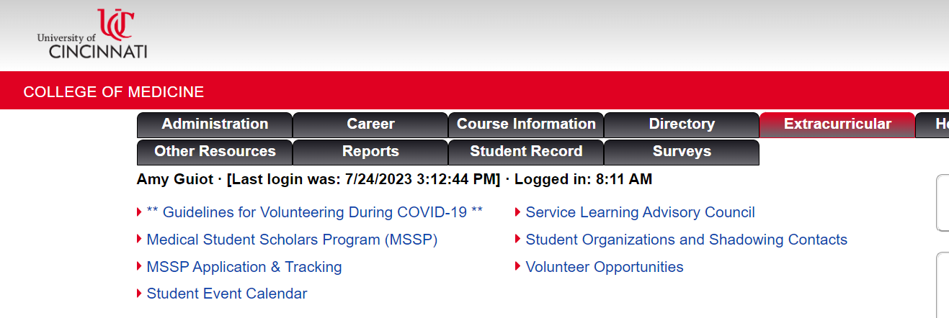

Slide 23

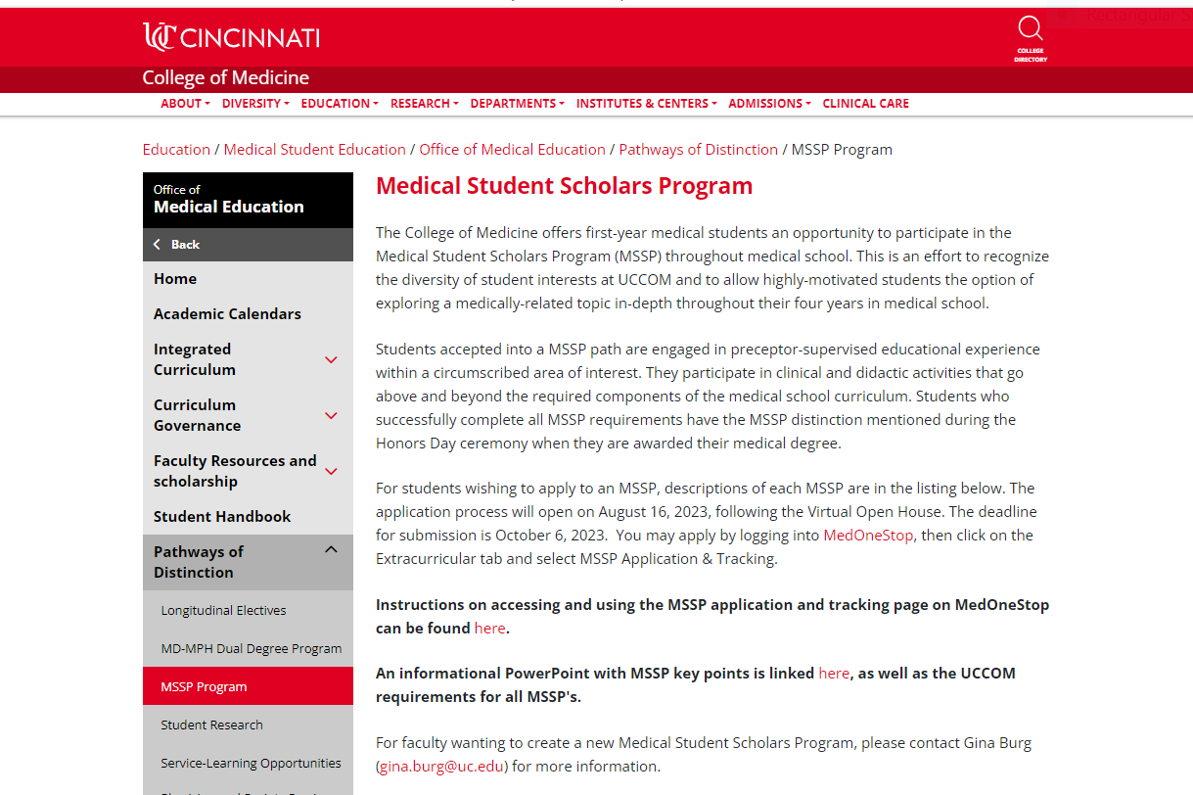
If click

Slide 24
Click on MSSP Application/Tracking

Slide 25
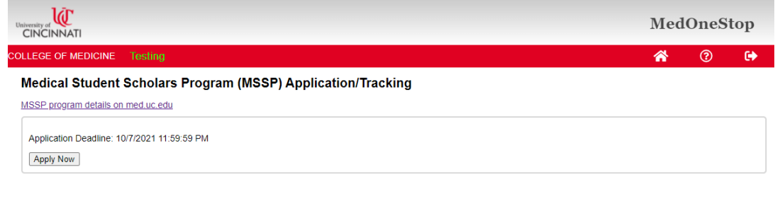
Click on Apply Now and all contact information is automatically uploaded

Slide 26
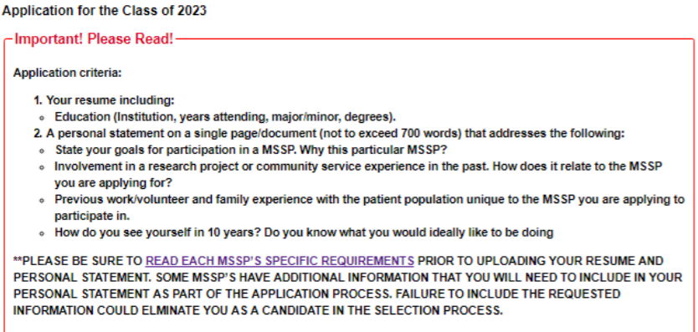
Application Instructions

Slide 27
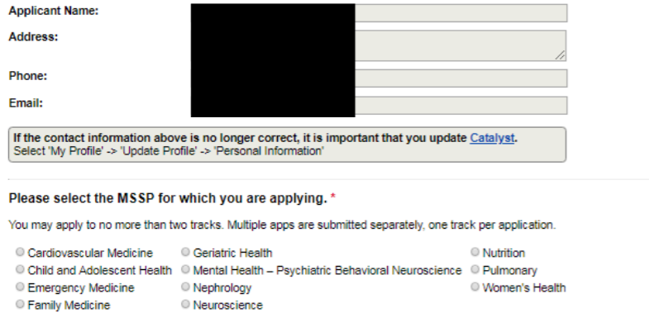
Application

Slide 28
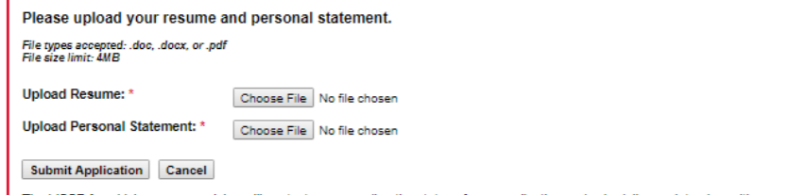
Application

Slide 29
More information
August 14th at noon for more scoop at VIRTUAL MSSP Informational Session.
Application instructions will be emailed after the informational session
Any other general questions please email amy.guiot@cchmc.org and Gina Burg gina.burg@uc.edu
Thank you!!

