Slide 1
Longitudinal Electives &
Medical Student Scholars Program (MSSP)
Amy Guiot, MD, MEd
Director, MSSP
Assistant Dean, Phase 3 Curriculum
Gina Burg, MS
Program Director, UCCOM - Office of Medical Education
Phase 2/3 Curriculum Support

Slide 2
Longitudinal Electives
Definition: Elective starting in Phase 1 spanning potentially through Phase 3 for which credit is applied to Phase 3 thus freeing up time in Phase 3 for other endeavors
May apply for consideration to more than one longitudinal elective but restricted to enrolling in only ONE longitudinal elective.
Students applying for a longitudinal elective should be in good academic standing. However, if a student experiences academic difficulty at any time while enrolled in the elective, consideration of withdrawal will be discussed with the elective director, student, and possibly advisor in the office of student affairs.
Options:
Healthy Children: Addressing Social Needs to Improve Health Outcomes (2 weeks credit)
Teaching in Medical Education (TiME) (4 weeks credit)
Medical Spanish Elective (4 weeks credit)
Foundations in Global Health Longitudinal Elective (4 weeks credit)

Slide 3
Healthy Children
Course Director: Keith Stringer, MD
Examines matters related to the fact that so many US children live in poverty, many of them facing challenges in gaining access to quality education, nutritious diets, intellectually stimulating activities and strong mentors who emphasize the importance of pursuing education and reaching their full potential.
Apply these important concepts to the community, and to understand their effects on vulnerable children both locally and abroad.
Particular interest to students with curiosity in pediatrics or family medicine or community health, with several sessions of particular interest to students undertaking mentoring activities with children.
Starts October of M1 to end of M2, mainly on Monday evenings

Slide 4
Teaching in Medical Education
Course Director: Caroline Gundler, PhD
Begins in the spring of your first year (M1) and continues through your fourth year (M4).
Designed to introduce students to learning theories, teaching skills and activities, and curriculum design. Through both didactics and practice (e.g., leading small group teaching, near-peer teaching), students will improve their mastery of pre-clerkship course knowledge, communication skills, professionalism, and teaching skills. Teaching responsibilities primarily occur in the M2 year, when students facilitate small-group learning sessions.
4 weeks credit in M4

Slide 5
Medical Spanish
Course Directors: Brittany Almarez, MD
Course Director: Brittany Almaraz, MD
Prepare students linguistically and culturally to provide care to Spanish speaking patient populations.
Occurs over the M1, M2 and finishes up at the end of the M3 year
An intensive summer course in between the first and second years. This meets every morning for four weeks during the summer. Students do have time for other experiences during this summer, including research and community service. Please note, students in certain MSSP's have been able to do both the summer course and MSSP but this requires working w/ their MSSP advisor to ensure that they can meet all Medical Spanish requirements. Students doing both MSSP and Medical Spanish should communicate with Dr. Almaraz to ensure they can make this work.
Simulated Spanish Patient Experiences (SSPEs), where native Spanish-speaking actors play patients, and students have the opportunity to practice their history and exam skills in Spanish and hear accents and vocabulary from around the Spanish-speaking world.
An evening seminar series on Wednesday evenings throughout the school year, focusing on specific cultural issues, such as immigration, mental health, and intimate partner violence.
Spanish conversation groups, led by second year medical students.
A variety of service-learning experiences in the Cincinnati Latino community at health fairs, free clinics, and other agencies.
4 weeks credit

Slide 6
Foundations in Global Health
Co Course Directors: Shanna Stryker, MD MPH and Rebecca Fujimura, MD
Designed for students interested in global health to the foundations of global health work.
Utilizing online modules, field experiences in Guatemala or another established partner site, and in-person evening seminars evaluations, students will develop key competencies in global health.
Students will spend two weeks working in Guatemala or Tanzania during the summer between M1 and M2 (self-funded, no language requirements). This can usually be planned around MSSP requirements
During their M2 years, students will participate in the medical evaluation of an individual seeking legal assistance for immigration as part of a medicolegal partnership. Key topics of discussion include: ethics of global health training and work, navigating and understanding global burden of disease, working with community health workers, global mental health, and HIV/TB/Malaria in global health, and non-communicable diseases in global health.
All coursework will wrap up by the end of M2

Slide 7
Timeline for Longitudinal Electives Process
  Mid-August – Application Opens Online
  Sept 21 midnight – Applications Due
  Oct 2 students contacted with decision
  Oct 7 students decide to accept/deny
  Oct 9 Directors move to waitlist to contact students
  Oct 12 Student final decision to accept/deny

Slide 8
Medical Student Scholars Program (MSSP)
PURPOSE:
To provide highly motivated students with a unique opportunity to explore a medical specialty in depth throughout their four years of medical school with a summer research experience culminating in publication and/or presentation.

Slide 9
MSSP Outcomes
Engage in mentored and preceptor-supervised educational experiences to expand fund of knowledge and skill set within a circumscribed area of interest longitudinally across all Phases 1-3
Partake in clinical and didactic activities
Participate in scholarly research project
Present and publish scholarly work
Achieve designated MSSP Scholar at Honors Day (Graduation)

Slide 10
MSSP 20 Tracks = 87 spots (48%)
Anesthesiology
Cardiovascular Medicine
Child and Adolescent Health
Dermatology
Emergency Medicine
Family Medicine
Geriatric Medicine
Infectious Disease
Integrative and Lifestyle Medicine
Nephrology
Neuroscience
OB/GYN – not accepting new for your class ☹
Oncology
Ophthalmology Surgery
Orthopaedic Surgery
Otolaryngology
Psychiatry
Pulmonary
Surgery
Transfusion Medicine ** new this year

Slide 11
2025 Match Data by MSSP
Cardiovascular Medicine – 1 Med-Peds, 1 General Surgery, 1 IM
Child and Adolescent Health – 4 peds, 1 med-peds, 1 neuro, 1 IM, 1 Gen Surg
Emergency Medicine – 2 EM, 1 urology, 1IM
Family Medicine – 7 FM, 1 IM
Geriatric Medicine – 1 IM, 1 Ophtho, 1 Anesthesia, 1 OB/GYN
Mental Health –1 psych, 1 peds, 1 peds prelim, 1 surgery
Nephrology – 2 IM, 1 OB
Neuroscience – 2 child neuro, 1 neurosurgery
Ophthalmology – 3 ophtho
Pulmonary - IM
Women’s Health – 5 OB/GYN, 1 FM, 1 derm
54% entered MSSP Specialty -> if assume IM goes into their MSSP then 64%

Slide 12
Min MSSP Requirements over 4 yrs
Didactic – 15 hours
  Lectures/ conferences
  Journal club
  Specialty interest group meeting
  MSSP group meetings
  Other
Clinical
  Shadowing/Experiential Opportunities – 10 hours
  M3 specialty elective if applicable
  M4 Elective
Scholarship – approx. 200 hours
  M1/2 Summer Scholarly Project
  Presentation of project at UCCOM Fall Research Symposium or other to include on CV
  Research 101 course
Service / Leadership – 8 hours
  Volunteer
  Committee Member
  Leadership roles
Mentorship

Slide 13
M1/Phase 1 Minimum Requirements
  Strive to participate in two “activities” per month averaged over a six month time period – any combination of above didactic, clinical, shadowing/experiential, service/leadership
  Meet a minimum of one time over the course of year one with mentor
  Complete the online course Research 101 prior to starting the summer research project (10 hours online asynchronous)

Slide 14
Summer Research between M1 and M2
  Research opportunity during the summer between M1 and M2
  Minimum of 200 student work hours for research project
  Culminate in a final project and at minimum be entered in the M2 Fall November Research and Service Symposium or other means for presenting/publishing for CV
  Students should strive to present at local, regional, or national conferences.
  Students should strive to publish.

Slide 15
M2/Phase 2 Minimum Requirements
  Strive to participate in two “activities” per month averaged over a six month time period – any combination of above didactic, clinical, shadowing, service/leadership.
  Meet a minimum of one time over the course of year one with their mentor

Slide 16
M3/Phase 2 Requirements
May request but not require student to participate in a specialty two-week elective during M3 (EM, Geriatrics)
Students will be given priority to the specialty elective.
Continue mentoring at least twice/year for research and planning of M4 or residency

Slide 17
M4/Phase 3 Requirements
Complete minimum of two week with most MSSPs requiring four-week clinical elective work in an area related to the specialty track
  Discuss with MSSP director

Slide 18
MSTP Students
May apply to an MSSP
Reach out to Dr. Ellis to discuss summer research commitment of MSSP with MSTP requirements

Slide 19
Longitudinal Elective
May NOT / DIFFICULT to participate in MSSP if enroll in Medical Spanish Elective due to required summer work
It is possible to do Global Health elective but must work with both directors due to 2 week summer work

Slide 20
MSSP Honors Notations
Students who successfully complete all MSSP requirements will have the MSSP distinction mentioned during the award of their medical degree at the College of Medicine’s Honors Day ceremony
Students may comment in the noteworthy characteristic on the MSPE of their success with the MSSP
Students may utilize the honors section of the ERAS application to share their MSSP experience

Slide 21
Financial Support
Sponsoring departments are encouraged, but not required, to provide financial support for students participating in the summer component of their track.
  Range to date $ 800 - $5000

Slide 22
Academic Expectations
  Maintain good academic and professional standing to move on from year to year in the MSSP.
  In the event that a student participating in the MSSP experiences academic difficulty at any time, consideration of withdrawal will be discussed with the MSSP director, student, and possibly advisor in the office of student affairs.

Slide 23
Enrollment
Variable number of students selected for each track
Students are selected by December of M1 with clinical activities and mentoring spanning all 4 years and research during M1/M2 summer.
Students will be required to log all MSSP “activities” in MedOneStop

Slide 24
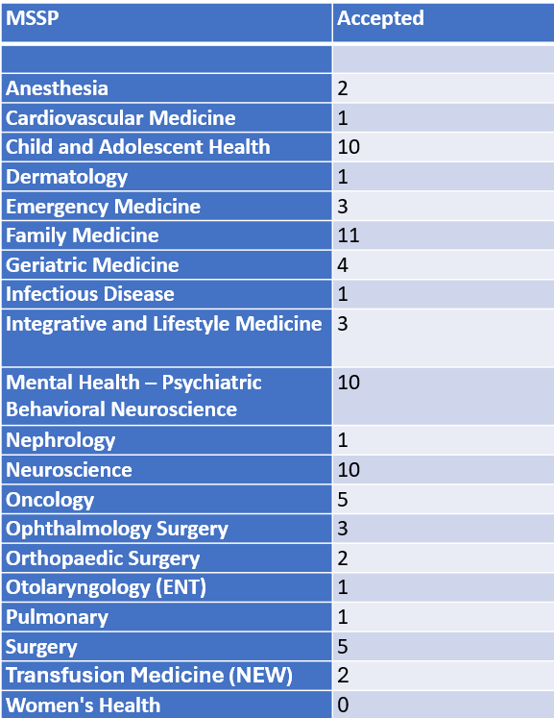
Expected Acceptance #s

Slide 25
Chat with current M4 students enrolled in MSSP

Slide 26
Selection Process
Students apply via MedOneStop
  Application opens August
  Submission deadline date October 12th midnight
  Decision date December
Applicants can apply to two programs marking first and second choice (likely need two different essays)
Applications are reviewed by individual MSSP departments to determine which candidates to accept
Applicants are interviewed by MSSP specialty track director (not me!)

Slide 27
Application
Very simple
After August 18th, Go to MedOneStop where majority/all of medical student information housed
Click on extracurricular tab
Click on MSSP Application/Tracking
Click on Apply Now and all contact information is automatically uploaded

Slide 28
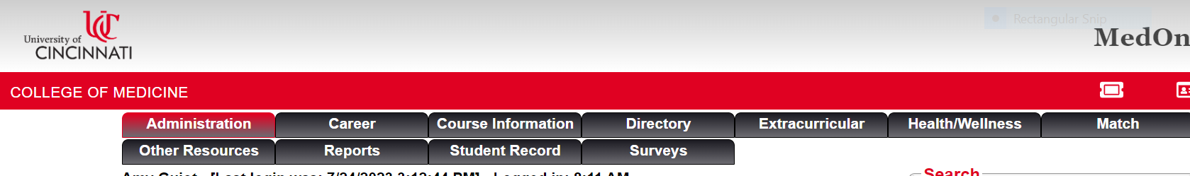
Click on extracurricular tab

Slide 29
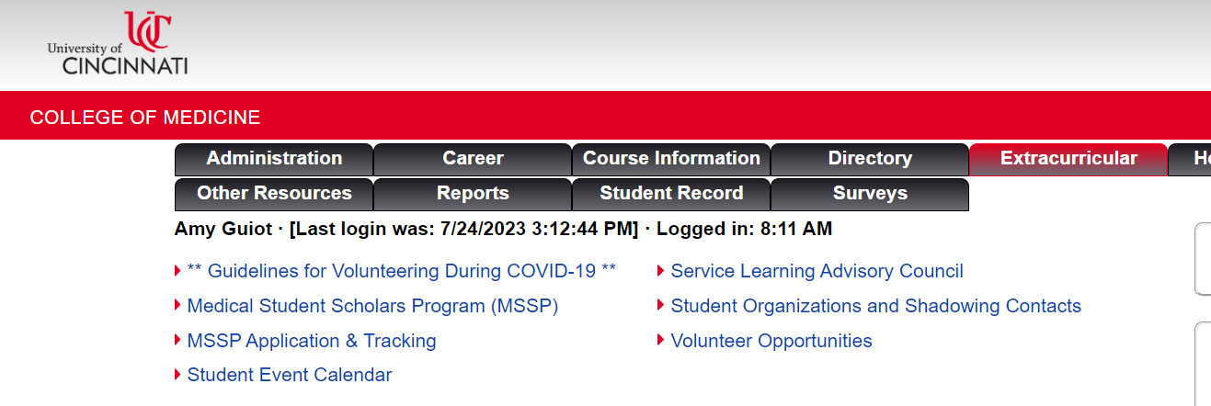

Slide 30

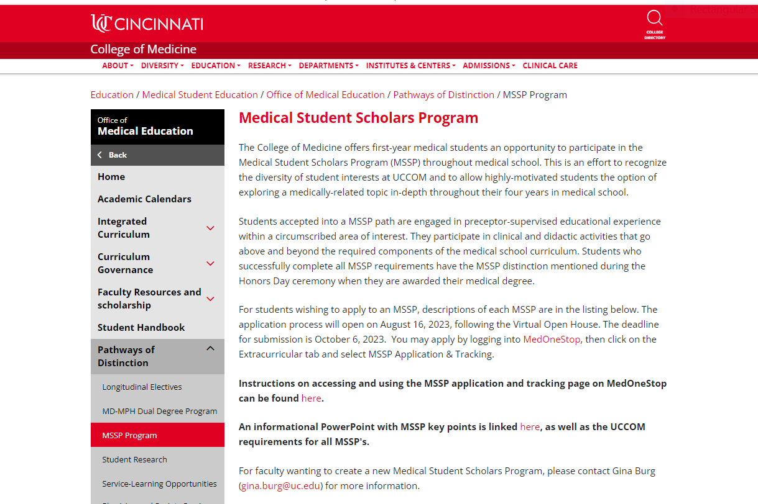
If click

Slide 31
Click on MSSP Application/Tracking

Slide 32
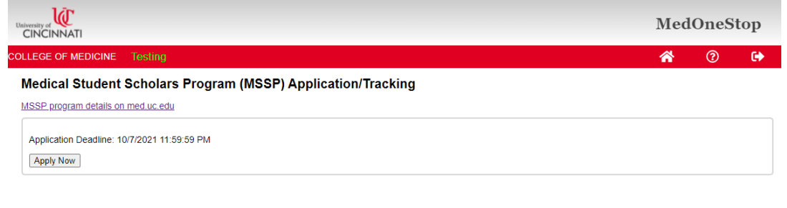
Click on Apply Now and all contact information is automatically uploaded

Slide 33
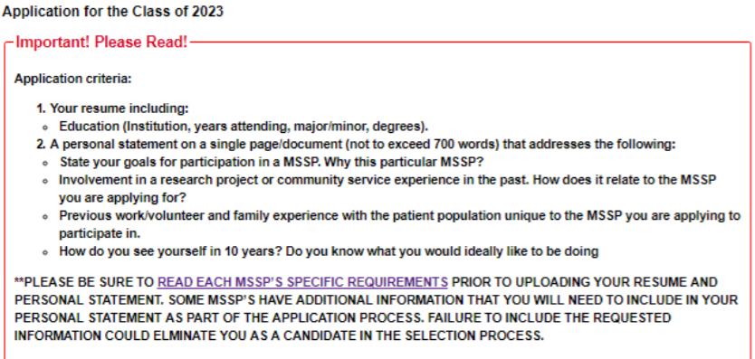
Application Instructions

Slide 34
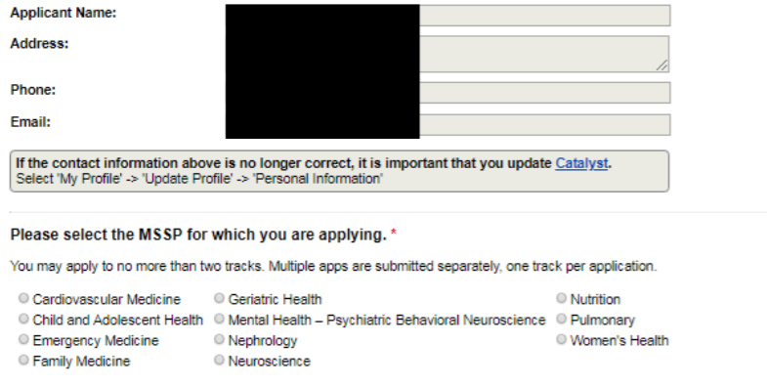
Application

Slide 35
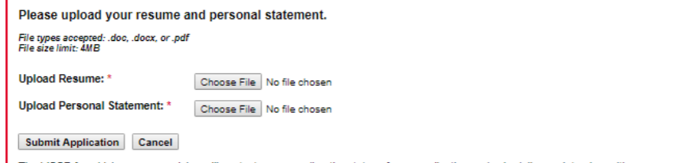
Application

Slide 36
New Decision Process Timeline
  Applications deadline - Monday, October 12th.
  Decision deadline - Monday, Dec 7th to notify students for round one
  Students will have until Friday, Dec 11th to accept or decline.
  Round two for MSSP to go to waitlist and send out more acceptances to fill spots by Tuesday, Dec 15th.
  Students will accept or decline round two by Friday, Dec 18th.
  If MSSP not filled, recruitment (student <=>MSSP director) by other means as long as acceptance completed by end of January.

Slide 37
More information
August at noon for more scoop at VIRTUAL MSSP Informational Session.
Application instructions will be emailed after the informational session
Any other general questions please email amy.guiot@cchmc.org and Gina Burg gina.burg@uc.edu
Thank you!!

