Slide 1

Belonging Matters:
Strategies to Increase Persistence, Confidence, and Mastery in Medical Students
October 7, 2026
Kimber Andrews, PhD | LPC
Associate Director | Center for the Enhancement of Teaching and Learning

Slide 2
Learning Objectives
Recognize how factors such as imposter syndrome, loneliness, and limited social connection can undermine students’ sense of belonging and negatively affect learning.
Explain the role of psychological safety, growth mindset feedback, and structured peer interaction in fostering a more inclusive and supportive classroom environment.
Identify 1-2 practices to integrate into the classroom that increase student belonging.

Slide 3

Why Belonging Matters
"I can focus my energies on my study because I know I belong here, I matter, and I can be myself."

Slide 4
What is Belonging
Basic Definition: “Sense of belonging (belongingness) is a psychological inference about the quality of fit or potential fit between a person and a social context” (Bahari et al., 2025)
It can be positioned as an innate need (psychological), a subjective feeling(socio-ecological), a form of membership and emotional attachment (political), and as relational work (relational). (Ajjawi, Eva, & Scott, 2026).
“In educational settings, belonging generally refers to the extent to which students feel personally accepted, valued, respected, included and supported by others in their learning environment (Goodenow & Grady, 1993)

Slide 5
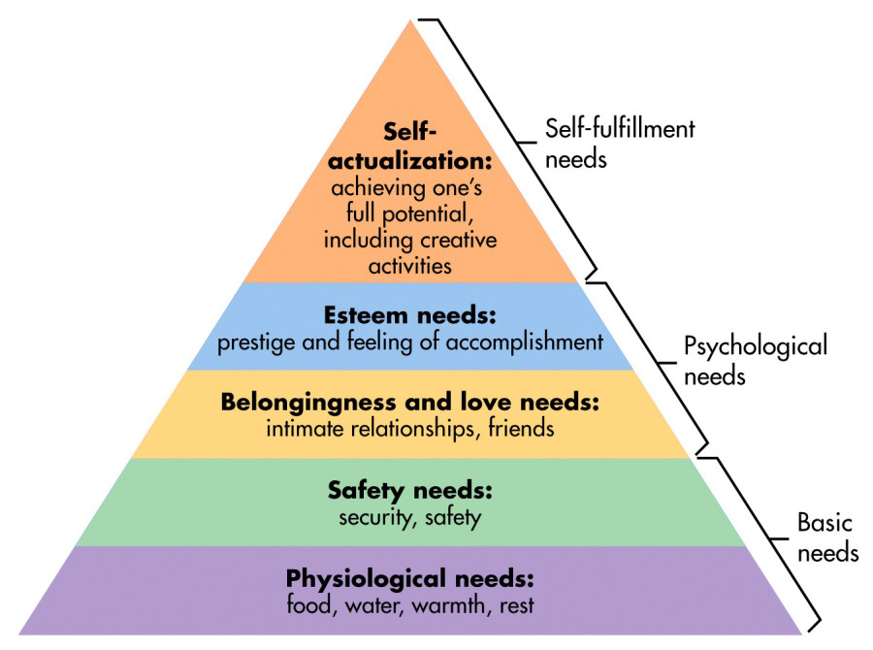
Characteristics of Belonging in Higher Ed
Belonging is a basic human need
Desire for belonging motivates behavior
Especially important in new environments & in identity formation
(Maslow, 1962 & Strayhorn, 2019)
Notes:
Example of students
Belongs because got good grades and can do intellectual rigor, but doesn't feel like they belong to the profession (identity, caring)
Student who belongs to profession (always wanted to heal/help) but feel they don’t belong because of grades

Slide 6
Why is Belonging Important in Medical Education
Medical learning environments can promote
Competition
Independence
Perfectionism
Self-sacrifice
Conformity
Culture of Stress & Performance
Lack of identity representation/role models, implicit bias, microaggressions, and lack of mentors with similar identity factors
(Ajjawi, Eva, & Scott, 2026) (Watling et al., 2021) (Rae, et al., 2024)

Slide 7
Positives of Belonging
Belonging protects students against stress and burnout, improves internal motivation, and promotes persistence and academic success. (Rae, et al., 2024)
Belonging is linked to increased physical and mental health, wellbeing, motivation, persistence, resilience, and academic success (Neufeld, 2025)
Increases clinicians willingness to speak up about errors and risks (Wawersik, et al., 2023)
Aides in cultivating an authentic professional identity that diversifies the field (Neufeld, 2025)

Slide 8
Strategies to Cultivate Belonging
Cultivating Psychological Safety
Providing High Impact Feedback
Implementing Structured Peer Interactions

Slide 9
Cultivating Psychological Safety
"I feel comfortable being myself and see myself as being a future medical professional"

Slide 10

Reflection Question
On a scale of 1-5, how psychologically and socially safe did it feel for you to make a mistake when you were a student in Med School?
1= Not safe at all (If I make a mistake, I am a failure)
2 = Somewhat safe (If I make a mistake, I will feel embarrassed)
3 = Safe enough (If I make a mistake, I will feel a little bad but can easily move on)
4 = Safe (If I make a mistake, I feel fine. Everyone makes them)
5 = Very safe (Mistakes are part of learning and if I am not making them, then I am not learning)

Slide 11
What is Psychological Safety
The feeling that one can take interpersonal risks without fear of negative consequences such as retaliation, intimidation, and rejection
A feeling that students can be their authentic selves rather than needing to take on a "doctor persona"
Empowers students to take risks including admitting a lack of understanding, questioning patient safety, or offering new ideas
(Bump & Cladis, 2024)
Notes:
Notes about student with "high pitched voice" told to lower for authority
Queer student told to dress more conservatively

Slide 12
Why is Psychological Safety Important?
Increased intentions to report medical errors
More likely to adopt protocols to reduce hospital-acquired complications
Less turnover in clinical environments
Lower rates of burnout
Lack of Psychological safety includes less asking for help, hiding mistakes, self-censoring and focus on identity preservation rather than learning/growing
(Bump & Cladis, 2024) (Neufeld, 2025)

Slide 13
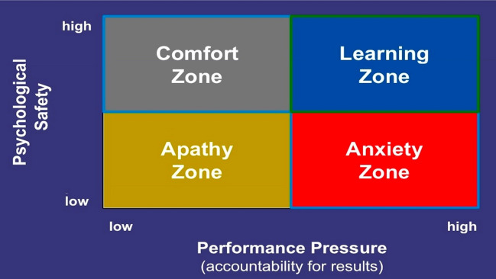
The 4 Quadrants of Learning and Safety
Psychological safety is achieved by having clear expectations with accountability paired with expectations that students learn through grappling and missteps.
(Neufeld, 2025)

Slide 14
Strategies for Psychological Safety
Include diverse representations of medical professionals (gender, race, class, age, body size, etc.)
Prioritizing skills needed for professional practice rather than a "personality type" or "style" that is to emulated
Getting regular feedback on teaching and incorporate it into your class to model a continuous growth mindset
Encourage and model vulnerability as part of the learning process through personal stories and improvements to the field through mistakes
(Bump & Cladis, 2024) (Neufeld, 2025)

Slide 15
Provide Growth Mindset Feedback
"We are here to F.A.I.L."
First Attempt In Learning
"I continuously grow through the process of doing, getting feedback, reflecting, and trying again."

Slide 16
What is Growth Mindset Feedback?
Focuses on effort, process, and strategy by connecting specific behaviors to observable outcomes
Frames mistakes and struggle as essential to learning
Uses forward-looking, actionable language that tells students not just what fell short, but exactly what to do next to grow
Recognizes and names growth explicitly throughout the learning process, not just feedback, or grades at the end
Applies consistent, competency-based language across all students, highlighting students skills progress and not their individual inherent intelligence
(Dweck, 2006)

Slide 17
Why is Growth Mindset Feedback Important?
Competency based education with an emphasis on "getting it right" can reinforce intelligence is fixed
Achievement gaps in under represented minatory students is heightened in STEM courses taught by fixed-mindset faculty
Fixed mindset often communicates a "who is smart, and not smart" dichotomy
Growth mindset focuses on effort, relationship building, and valuing diverse perspectives in the learning process encouraging curiosity, resilience and belonging
(Araten et al., 2026) (Campbell, Theard & Harrison, 2020)

Slide 18
Growth Mindset Feedback Strategies: 1
Explicitly connect effort to outcomes
  Fixed: "He worked hard through the rotation."
  Growth: "Due to his hard work coordinating the discharge plan, our team was able to discharge the patient safely to home."

Slide 19
Growth Mindset Feedback Strategies: 2
Contextualize challenges as part of the process AND identify next steps
  Fixed: "You missed a key finding in the patient presentation. You should already know this."
  Growth: "You missed a key finding in this patient presentation today. Work on building a systematic approach to build consistency. This is exactly what you should be working on as you build competency.

Slide 20
Growth Mindset Feedback Strategies: 3
Replace personality descriptions with observable behaviors
  Fixed: "She was quiet, and a very pleasant student."
  Growth: She listens carefully and offered well-reasoned responses during case discussions when directly asked.

Slide 21
Growth Mindset Feedback Strategies
Design Rubrics to Include Growth Mindset Principles
  Emerging: You are beginning to build your understanding of the task or content and benefit from frequent support as you learn.
  Developing: You are strengthening your understanding of the task or content and are starting to apply it with some support.
  Proficient: You have developed a clear and consistent understanding of the task or content and can apply it with minimal support.
  Advanced: You have built a deep and flexible understanding of the task or content and can apply it independently and effectively in new situations.

Slide 22
Implement Structured Peer Interactions
"I have meaningful conversations about learning with my peers and feel I have trusted connections when I have questions."

Slide 23
Question of the Day
Getting to know students
  Share a song that always puts you in a good mood?
  If you could have a super power what you want it to be?
  If you could be a character in a TV show, who would you be?
Normalizing challenges and cultivating a growth mindset
  What is stressing you out most this week?
  What is one word describing how you are feeling about this week's topic?
  Name something that has gotten a tiny bit easier this semester?
  Name one thing—it can be really small—that you are proud of?
Reflections on learning
  Identify a concept that you understand for the most part, but you still have questions.
  What do you think would benefit the whole class if we reviewed it again.
  What is one thing you have tried that has helped you to study for this class and absorb the content?

Slide 24
Peer Support Triads
At the start of the semester group three students together and provide weekly or bi-monthly check-in prompts. See examples below
Review assignment prompts and generate questions, concerns, and strategies to complete the work
Compare notes at the end of a class and discuss notetaking strategies
Share study and focus strategies that are working and challenges
Create a list of questions of what they think will be on the exam and submit to instructor
Make these timely and related to curriculum and personal development of student skills.

Slide 25
Small Group Work and Assigned Roles
Design a task to complete (case study, discussion prompt, etc.) with a clear deliverable. Divide the class into small groups (4-6) and ask each student to volunteer for a specific role. Possible roles include
Notetaker
Skeptic/questioner
Facilitator/timekeeper
Summarizer/connector
Spokesperson/reporter
Provide regular prompts throughout the work-time to encourage students to stay on task and address any questions that arise as you circle the room and listen to how groups are working with the prompt.

Slide 26
Summary
Belonging is cultivated through day to day interactions and building a relationship with students
Students that feel that they belong have more cognitive energy to devote towards skill development
Instructors can cultivate belonging through designing LEARNING spaces instead of spaces for students to perform knowing
Designing learning experiences that highlight a diversity of successful clinicians can increase a sense of belonging for under represented students

Slide 27
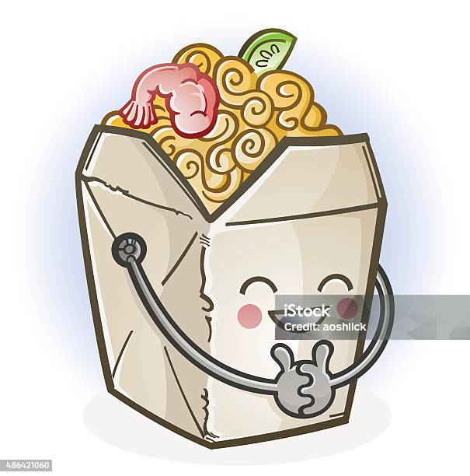
Take-Away
Reflect on ONE strategy or idea that you want to take back to your teaching this semester.
If you would like to share, put your idea in the chat.

Slide 28

Questions
If you have any additional questions or would like to schedule a time to chat about how to implement some of these practices in your specific courses, contact me at:
kimber.andrews@uc.edu
Thank you for your time, attention and all you do to support your students.

Slide 29
References
Ajjawi, R., Eva, K. & Scott, I. Reflections on four theoretical perspectives of belonging. Adv in Health Sci Educ 31, 961–975 (2026). https://doi.org/10.1007/s10459-025-10476-x
Araten, S., Gokhale, S., Pradhan, A. et al. A New Approach to Cultivating Growth Mindset: Strengths-Based Training for First-Year Medical Students. Med.Sci.Educ. 36, 1907–1909 (2026). https://doi.org/10.1007/s40670-026-02786-5
Bahar Saberzadeh-Ardestani, Andrea N Leep Hunderfund, Darcy A Reed, Ellen L Usher, Measuring Sense of Belonging Among Current and Future Physicians: A Systematic Review, Academic Medicine, Volume 100, Issue 11, November 2025, Pages e68–e79, https://doi.org/10.1097/ACM.0000000000006199
Bump GM, Cladis FP. Psychological Safety in Medical Education, Another Challenge to Tackle? J Gen Intern Med. 2025 Jan;40(1):41-45. doi: 10.1007/s11606-024-09166-y. Epub 2024 Oct 28. PMID: 39467951; PMCID: PMC11780054.
Campbell J, Theard MA, Harrison R. The growth mindset in medical education: A call for faculty development. EClinicalMedicine. 2020 Nov 20;29-30:100648. doi: 10.1016/j.eclinm.2020.100648.
Dweck, C. S. (2006). Mindset: The new psychology of success. Random House.
Goodenow, C., & Grady, K. E. (1993). The relationship of school belonging and friends' values to academic motivation among urban adolescent students. Journal of Experimental Education, 62(1), 60–71. https://doi.org/10.1080/00220973.1993.9943831
Maslow, A. H. (1943). A theory of human motivation. Psychological Review, 50(4), 370–396. https://doi.org/10.1037/h0054346 [1]
Neufeld, A. (2026). Belonging Without Controversy: Using Self-Determination Theory to Reframe Inclusion in Medical Education. Teaching and Learning in Medicine, 1–7. https://doi.org/10.1080/10401334.2026.2636185
Rae, V.I., Smith, S.E., Hopkins, S.R. et al. From corners to community: exploring medical students’ sense of belonging through co-creation in clinical learning. BMC Med Educ 24, 474 (2024). https://doi.org/10.1186/s12909-024-05413-2
Strayhorn, T. L. (2020). Exploring the role of race in black males’ sense of belonging in medical school: A qualitative pilot study. Med Sci Educ, 30(4), 1383–1387. https://doi.org/10.1007/s40670-020-01103-y - DOI
Wawersik, D. M., Boutin, E. R., Gore, T., & Palaganas, J. C. (2023). Individual characteristics that promote or prevent psychological safety and error reporting in healthcare: A systematic review. Journal of Healthcare Leadership, 15, 59–70. https://doi.org/10.2147/JHL.S369242
Watling, C., Ginsburg, S., LaDonna, K., Lingard, L., & Field, E. (2021). Going against the grain: An exploration of agency in medical learning. Medical Education, 55(8), 942–950. https://doi.org/10.1111/medu.14532 - DOI

