Slide 1
UC College of Medicine Center for Addiction Research (CAR)
Summer Speaker Series
Sponsored by: Center for Clinical & Translational Science & Training
August 14, 2024
12:00 – 1:00PM
This event is being recorded.
Participants can enable captions in the taskbar under more.

Slide 2
Center for Addiction Research (CAR)
The CAR was launched in October of 2020
Mission: to support cross-disciplinary collaborations across UC as well as with community partners, governmental institutions, and other academic institutions in order to accelerate scientific progress in addiction prevention and treatment
Twenty-nine faculty from six UC Colleges
CAR Website: https://med.uc.edu/institutes/CAR/home

Slide 3
CAR Website
Publications: https://med.uc.edu/institutes/CAR/publications
Projects:
https://med.uc.edu/institutes/CAR/projects
Communications:
https://med.uc.edu/institutes/CAR/communications
To become an affiliate member:
https://med.uc.edu/institutes/CAR/car-member-registration

Slide 4

The COM CAR Summer Speaker Series
Supported by an award from the Center for Clinical & Translational Science & Training
Thank you to Jen Rowe for planning assistance.

Slide 5
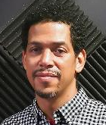

The COM CAR Summer Speaker Series
Special thank you for operational assistance from:
Jermaine Fields – UI/UX Lead, UC DTS Application & Software Development/ COM Web Development
Todd Schutter –Multi-Media Coordinator, UC DTS COM

Slide 6
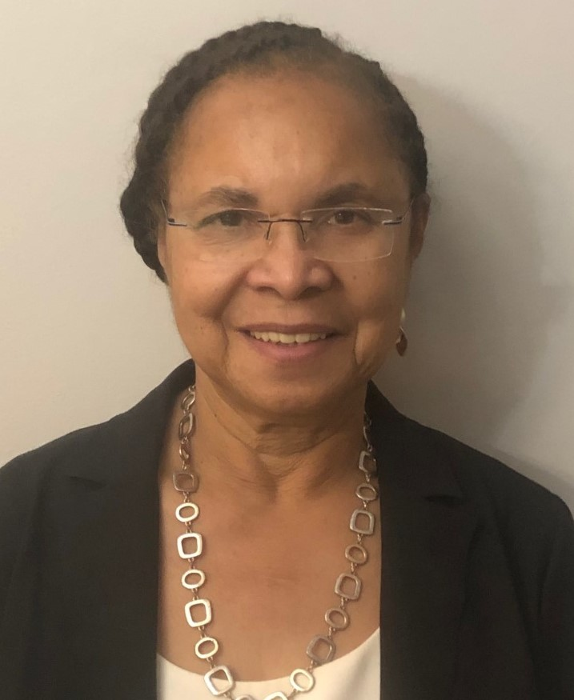

Social and Psychosocial Determinants of Treatment Response and Recovery Among Black Adults Who Use Substances
Kathy Burlew, PhD
University of Cincinnati
Simeon Goodwin, PhD
The Crossroads Center

Slide 7
Learning Objectives
To share research findings demonstrating the effectiveness of treatments that incorporate social-contextual and psychosocial factors for Black adults who use cocaine.
To share novel approaches to engaging with Black adults who use substances.
To describe gaps that need to be addressed in research and treatment with Black adults who use substances.

Slide 8
Lessons Learned from Research and Field Experience to Identify Social and Psychosocial Determinants of Treatment Among Black Adults
Who use Substances
Part 1: Using research to understand effective treatment components for Blacks who use substances
Part 2: Using field experience to understand the social context of substance use among Blacks who use substances (particularly those not yet seeking treatment)
Discussion

Slide 9
Racial/Ethnic Differences in
Substance Use
Factors related to treatment entry
Overdose rates (Cano et al., 2020)
Enter treatment later in the addiction process (Montgomery et al., 2019)
Consequences for use (Cano et al., 2022; Nicholson Jr & Ford, 2019)
Response to treatment
Treatment completion (Mennis & Stahler, 2016; Saloner & Cook, 2013)
Treatment efficacy (SAMHSA, 2020,2020)
Notes:
Danny---

Slide 10
Evidence-Based Interventions: Background
Treatments demonstrated scientifically to be effective at reducing symptoms for specific conditions
Concerns
Advantages
Provide some evidence of activities that may be beneficial
Appeal to funders
Evidence often not based on findings for Blacks and/or other racial/ethnic minoritized (REM) individuals
Findings may not generalize to REMs
Evidence-based interventions may not address unique factors related to outcomes among REMs
Notes:
Danny---

Slide 11
Effectiveness of Evidence-Based Treatments for Black People
Current treatments for substance use are often developed for the “general population” without consideration of these unique experiences for Black people
Many gold-standard interventions are limited in their inclusion of:
  SDOH
  Impact of Racism
  Racial identification
  Cultural factors
Due to this limitation, evidence-based interventions should be carefully considered for appropriateness with Black communities and, if necessary, culturally adapted as appropriate
Notes:
Danny---

Slide 12
So……how do we proceed?
One Option
Evaluate which Evidence-Based Interventions (EBIs) have promise for racial/ethnic minoritized (REM) populations
Identify the treatment components related to positive and negative treatment response
When appropriate, modify promising EBIs to be even more effective for Blacks and other REMs

Slide 13
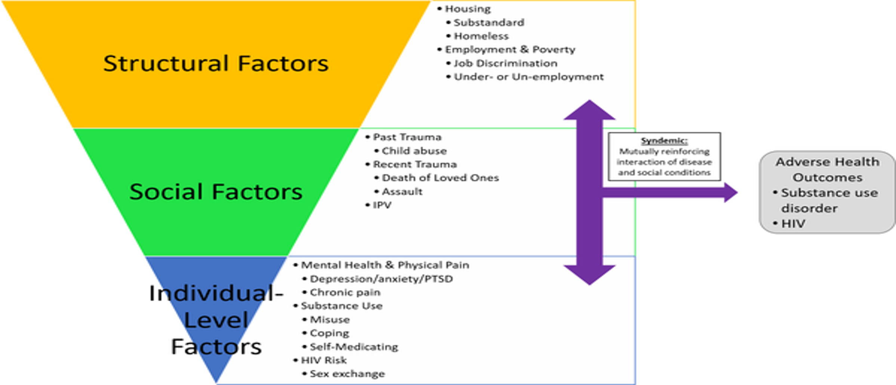
Substance use among Black people linked to psychosocial and social-contextual factors (e.g. trauma, mental health, family social relationships)

Slide 14

Our work addresses that gap

Slide 15

Part One
Integrative Data Analysis of CTN Studies to Examine the Impact of Psychosocial Treatments for Black People Who Use Cocaine
(No Conflicts to Disclose)
MPI
A.Kathleen Burlew, PhD
Lesia Ruglass, PhD
Senior Researchers
Adriana Espinosa, PhD
Antonio Morgan-Lopez, PhD
Ayana Jordan, MD, PhD
LEAD Scholars
Angela Haeny, PhD
Caravella McCuistian, PhD
Graduate Students
Joel Lopez, MA
Christopher Roundtree, MA
EMMES (CTN Data Management Center)
Ashley Venner, PhD
Notes:
NIDA study funded through the NIDA Clinical Trials Network

Slide 16

Aims
Aim 1) Estimate scale scores of cocaine use severity while considering study-level measurement non-invariance
Aim 2) To investigate the comparative effectiveness of behavioral treatments among Black adults who use cocaine
Aim 3) Explore individual (e.g., concomitant opioid use, age, sex, employment, pre-treatment psychiatric status) and study-level moderators (e.g., attendance/retention) to evaluate subgroup differences in treatment effectiveness.

Slide 17
Hypothesis
Substance use treatments that address social-contextual factors will yield better outcomes than:
Treatment-as-usual (TAU)
Non-social-contextual interventions (Treatments that focus only on substance use)

Slide 18
Study Utilized Integrated Data Analysis (IDA)
What is an Integrated Data Analysis (IDA)?
A set of strategies in which two or more independent data sets are pooled or combined into one and then statistically analyzed.
IDA requires recoding the data so that the variables are similar across data sets.
IDA is useful for creating larger samples for conducting research.
Notes:
An easy example might be that one study might code men as 0 and women as 1 but another study might code women as 0 and men as 1. We can easily recode so that 0 means the same thing in both studies. Coding can get more complicated---look to find the lowest common denominator--- variable coded as yes and no in one study but no, sometimes, often and always in another. Sometimes, often, and always might need to be recoded as yes in the second study so that both studies now have yes and no. This technique is called ‘harmonizing the data’

Slide 19

Method
Secondary Analysis of 9 Randomized Clinical Trials Conducted within the NIDA Clinical Trials Network
Selection of Interventions Criteria:
Behavioral intervention
Targeted substance use or substance use disorder
Included Black participants in the sample
Outcome measures included cocaine and psychostimulant use (biological, self-report, clinician-administered) and consequences.

Slide 20
Selected Interventions: 3 Treatment Conditions
Social-contextual Interventions
Motivational Interviewing (MI, CTN 0005)
Motivational Enhancement Therapy (MET; CTN0004),
MET for pregnant women (CTN0013),
STAGE 12 (CTN0031),
Seeking Safety (CTN0015),
Therapeutic Education System (TES, CTN0044).
Interventions that did not focus on social-contextual factors
Contingency Management for Drug Free Clinics, (CM; CTN0006),
CM for Methadone Clinics (CTN0007),
Screening, Motivational Assessment, Referral, and Treatment in Emergency Departments (SMART-ED; CTN0047) (SBIRT).
Treatment as Usual/Behavioral Control (Reference group)
Examples
Non-manualized control
Women’s health education

Slide 21

Selection of Cases
Criteria
Enrolled in a participating protocol
Self-identified as Black
Either self-reported cocaine use or positive urinalysis for cocaine during the 30 days prior to enrollment in the study.

Slide 22
Sample Characteristics Across Trials
92.3% Monoracial Black
Mean Age: 39.98 (SD = 10.17)
51.7% Male
56.2% Single/Never Married
75.5% High School Degree or lower

Slide 23

Outcome variable was a latent substance use measure
Self-reported # days used in the past 30 from the Addiction Severity Index(ASI)
Positive Urinalysis (UDS; all 9 trials)
Notes:
We think of a latent variable as being an unmeasured variable that is believed to influence responses to a number of survey items. An unmeasured variable simply means that we don't have a perfect measure of it, but it's something that we develop questions to ask about.
Latent outcome indicator included both self reported and urinalysis

Slide 24
Analysis Plan
Examined the comparative effectiveness of:
treatments that address social-contextual factors along with substance use
  AND
treatments that do not address social-contextual factors (Contingency management and SBIRT)
  RELATIVE TO
treatment as usual on cocaine (TAU)

Slide 25
Latent Cocaine Use Severity Results
Baseline through End-of-Treatment
  Cocaine use severity across all three treatment groups decreased
  Additional decrease for Social-contextual above-and-beyond TAU (p = .04)
  Contingency Management/SBIRT no different than TAU (p = 0.24)

Slide 26
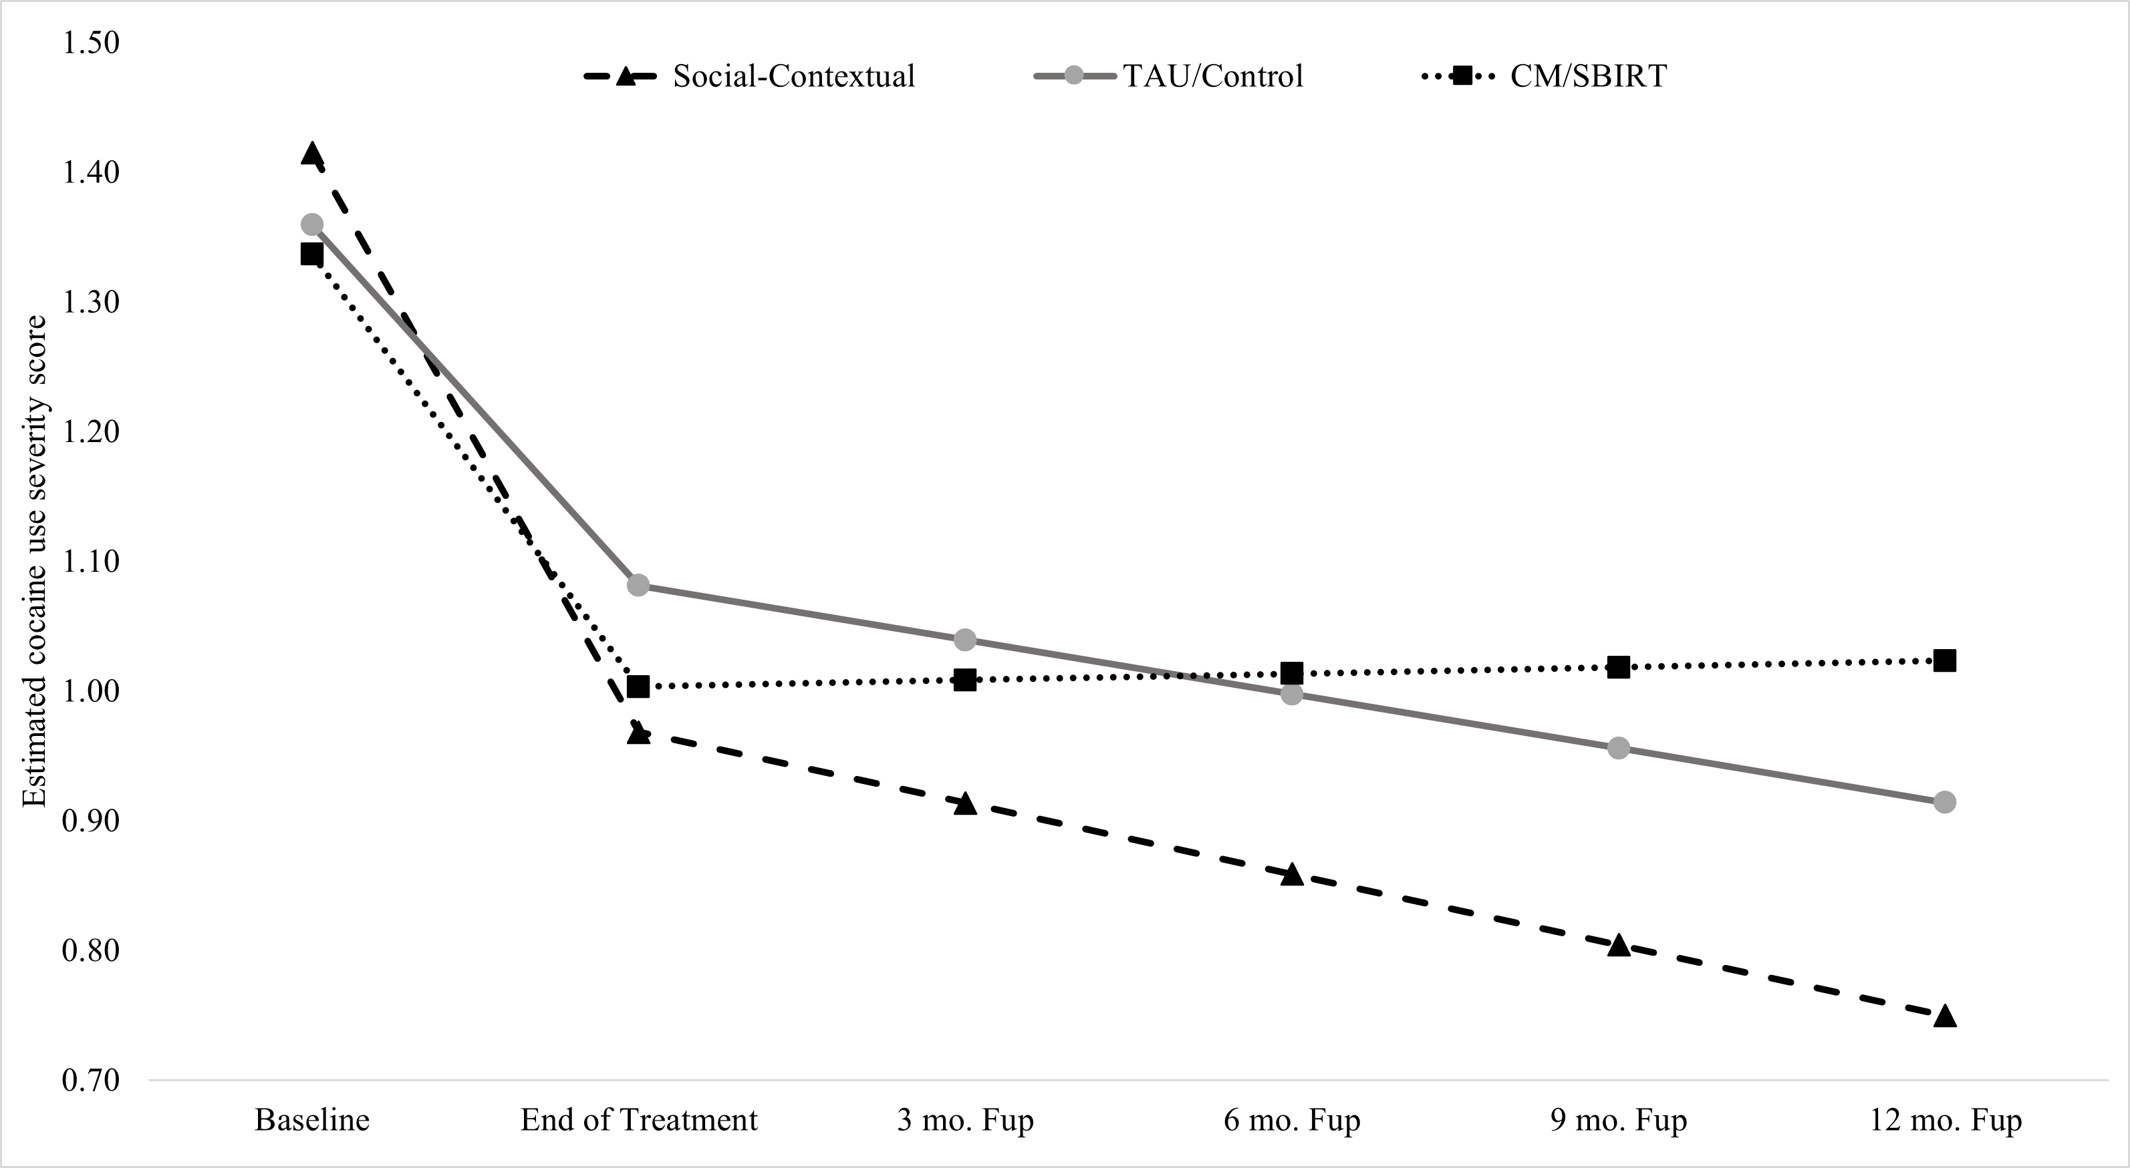
Figure 1. Cocaine use severity across treatment classifications throughout treatment and 12-month follow-up (N = 1381)

Slide 27
End of Treatment Results

Slide 28
End-of-Treatment through 12 Month Follow-up
  Social-contextual and TAU continued to decrease at a similar rate
  Non-social-contextual interventions (Contingency Management/SBIRT severity) significantly worse than TAU (p = .04)

Slide 29
Figure 2. Cocaine use severity across treatment classifications throughout treatment and 12-month follow-up

Slide 30
Within Group Variations
Variations in the Social-contextual
Significant Reductions in Substance Use Severity
Seeking Safety
Motivational Enhancement Therapy
Motivational Interviewing
Stage 12
Nonsignificant change in substance use severity
MET for pregnant people
Therapeutic Education System (TES)
Variations between Contingency Management and SBIRT
Significant Reductions in Substance Use Severity
Contingency Management
Nonsignificant change in substance use severity
SBIRT

Slide 31
Discussion and Implications
The findings at the end-of-treatment suggest that interventions treating cocaine use among Black people might prove more effective if they also address social-contextual factors (e.g., trauma, self-efficacy, social support, relationship functioning, and community resources).
  Addressing these factors may enhance coping strategies and build resilience in the face of co-occurring conditions tied to the substance use.
The added benefit of social-contextual treatments relative to TAU/Control was maintained at follow-up, suggesting long-terms gains for those who received the social-contextual treatments in terms of lower cocaine severity scores
Notes:
Set this up so one bullet appears at a time

Slide 32

Limitations and Strengths
LIMITATIONS
Studies did not include unique risk (e.g., racial trauma) and protective (e.g., racial identity) known to be important for addressing substance use among Black people..
The available studies to date determined the included studies; for this study, only nine trials met inclusion criteria.
Although many of the studies pooled had similar approaches (e.g., motivational interviewing and motivational enhancement therapy), diversity was evident in treatment type and what was considered TAU or control.
Recent changes in the socio-political context corresponding to the use of substances warrant the need for replication studies.
STRENGTHS
Small sample size problem circumvented by using IDA to generate a larger sample of Black adults that allows answering questions specific to this population
Estimation of latent severity scores that combined self-report and biological data (urinalysis), yielded a more comprehensive measure of treatment outcomes than using either data type separately
Examinations of end-of-treatment and follow-up provide unique information about the long-term effects of these interventions.

Slide 33
Conclusions
The study design demonstrates how integrative data analysis is a viable approach to addressing the small sample problem due to the underrepresentation of Black people in existing clinical trials.
The study findings highlight social-contextual factors as essential treatment components for reducing cocaine use among Black adults beyond TAU.
What can we learn in the field about social factors related to enhancing Black substance use treatment.

Slide 34
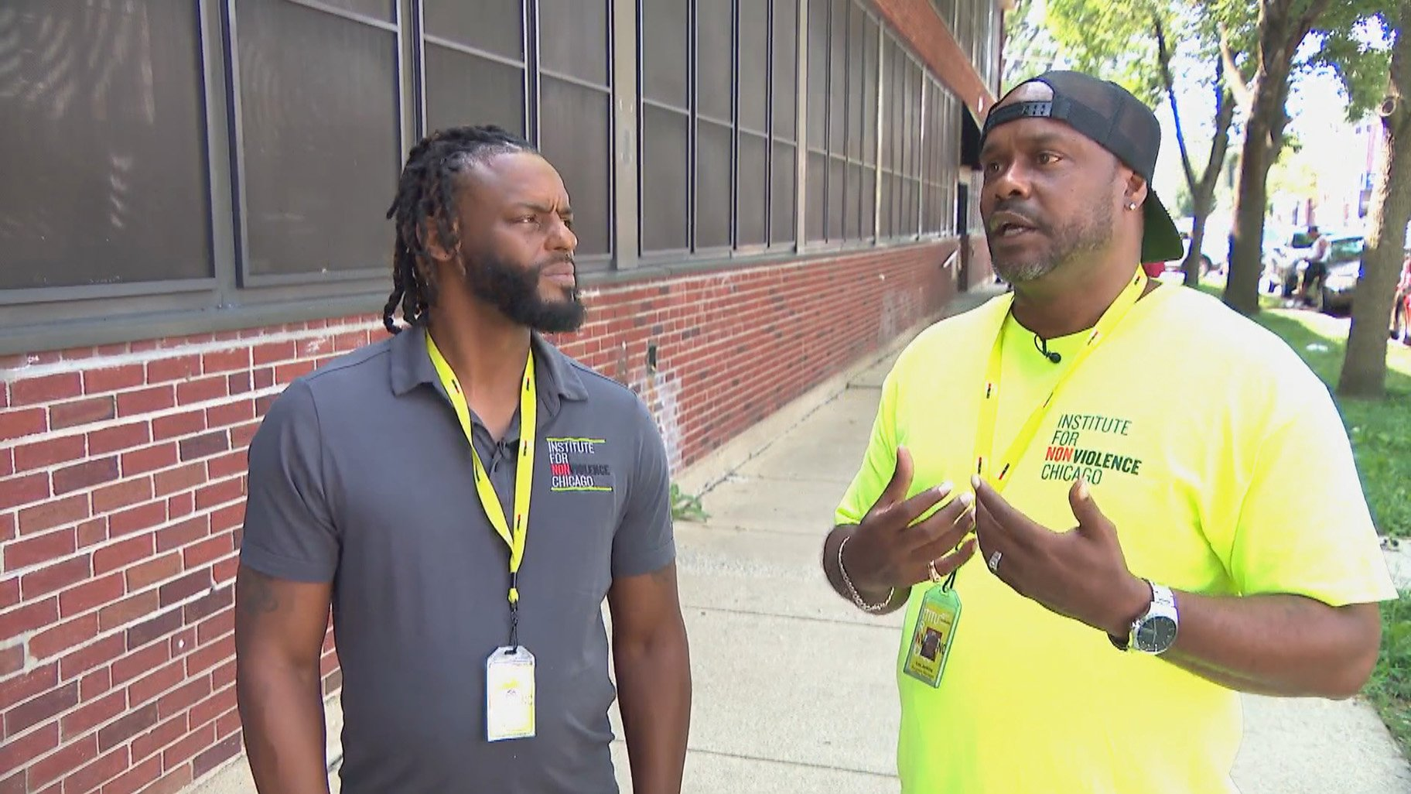
Outreach and Lessons Learned From The Field
Dr. Simeon Goodwin

Slide 35
What I do
Outreach
  On the street
  Non-profit agencies
  Mental Health Court Teams
Behavioral and Substance Use Prevention
  Work in primary education settings to address social-emotional well-being and substance use
Smoking Cessation Treatment
  Tobacco use education for TCC for residential clients

Slide 36

Outreach
Activities
  Agency services information dissemination
  Narcan distribution
  Screen individuals seeking services

Slide 37
Lesson One
Get to know and be known in the community! This will help you build your credibility, and the community will see you as an asset. Find a location where you can always be found. Get to know the names of the people who pass by – strive to understand their stories as much as they will allow.

Slide 38

Lesson Two
Services that I and other agencies have to offer are in significant competition with the resources the individual feels they have. Using a strengths-based approach is very helpful for engaging the individual.

Slide 39

Lesson Three
Your priorities for an individual may not be their priorities. Sometimes, you have to remain compassionate when you have to repeatedly engage with them in the hopes of helping them cross whatever bridge they have to cross.

Slide 40
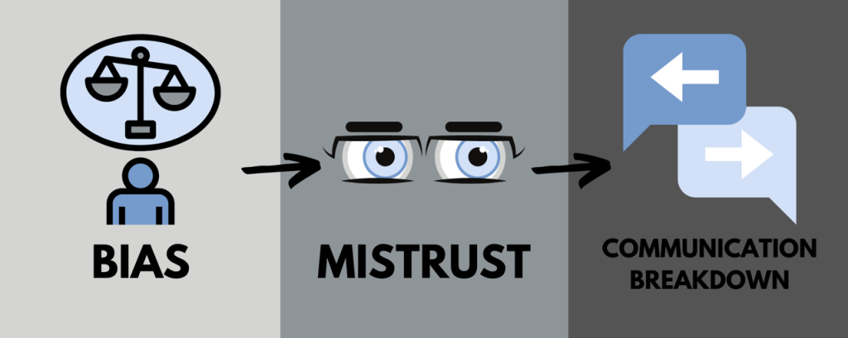
Lesson Four
Racism, stigma, and otherness are prevalent and serve as a significant barrier to helping the person struggling with their mental health and or substance use.

Slide 41

Lesson Five
Potential clients may have barriers to treatment that are not immediately visible.

Slide 42
References
Cano, M., Oh, S., Salas-Wright, C. P., & Vaughn, M. G. (2020). Cocaine use and overdose mortality in the United States: Evidence from two national data sources, 2002–2018. Drug and Alcohol Dependence, 214, 108148.
Mennis J, Stahler GJ. Racial and ethnic disparities in outpatient substance use disorder treatment episode completion for different substances. J Subst Abuse Treat. 2016.
Montgomery LT, Burlew AK, Haeny AM, Jones CA. A systematic scoping review of research on black participants in the National Drug Abuse Treatment Clinical Trials Network. Psychol Addict Behav. 2019;34(1):117–27.
Nicholson Jr, H. L., & Ford, J. A. (2019). Sociodemographic, neighborhood, psychosocial, and substance use correlates of cocaine use among Black adults: Findings from a pooled analysis of national data. Addictive Behaviors, 88, 182–186.
Saloner B, Cook BL. Blacks and Hispanics are less likely than Whites to complete addiction treatment, largely due to socioeconomic factors. Health Aff. 2013;32(1):135–45.
Substance Abuse and Mental Health Services Administration. The Opioid Crisis and the Black/African American Population: An Urgent Issue. [Internet].2020. https://store.samhsa.gov/sites/default/files/pep20-05-02-001.pdf
Substance Abuse and Mental Health Services Administration. The Opioid Crisis and the Hispanic/Latino Population: An Urgent Issue [Internet].2020. https://store.samhsa.gov/sites/default/files/pep20-05-02-002.pdf

Slide 43
Thank you!
Kathy Burlew Kathy.burlew@uc.edu
Simeon Goodwin Simeon.Goodwin@thecrossroadscenter.org

Slide 44
Q&A
Please unmute to ask a question OR type your question in the chat box.

Slide 45
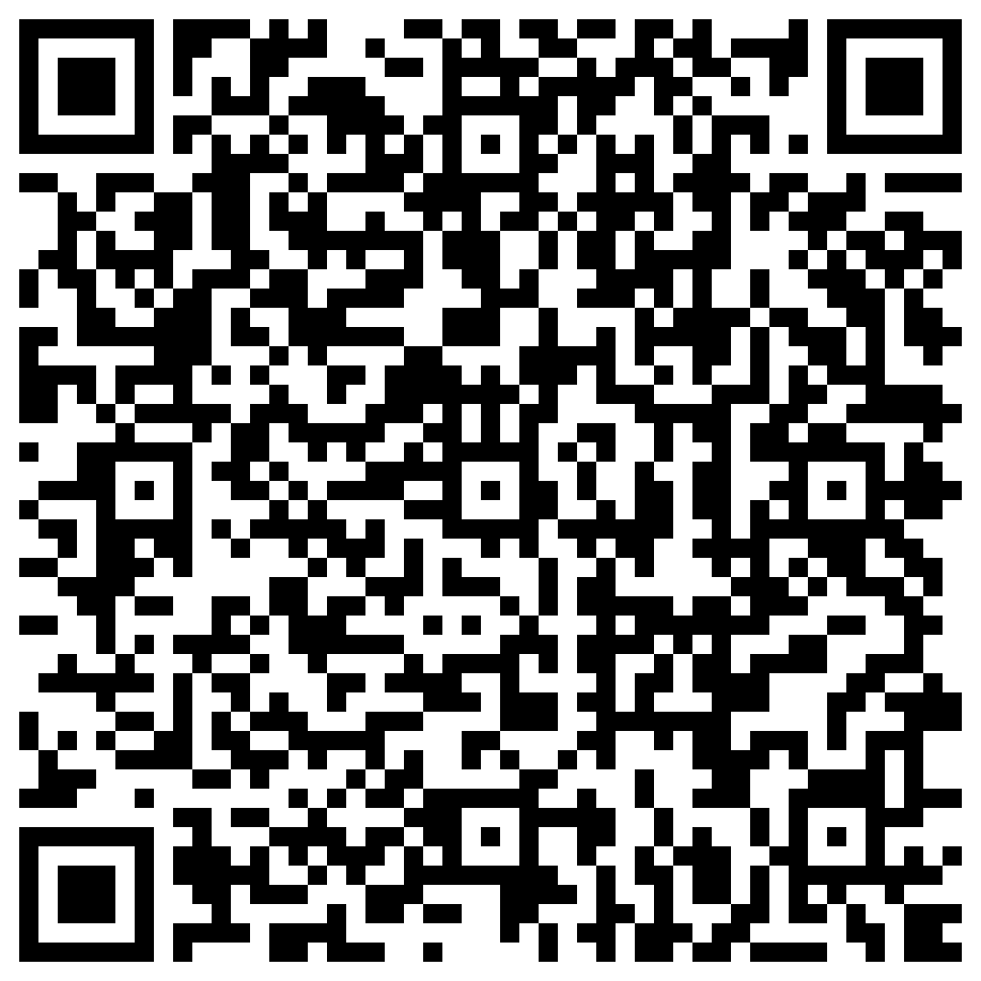
Thank you for joining us!
Please take a few moments to complete the survey form. Scan the QR code below or use the survey link provided in the chat box, both will be emailed.
The form is required to complete if requesting CE credit for Psychology, Social Work, or Counseling.

Slide 46
All Summer Speaker Series event recordings can be found by visiting
the CAR website.
Thank you for attending!
med.uc.edu/institutes/CAR/summer-speaker-series/speaker-series-2024

