Slide 1
UC College of Medicine Center for Addiction Research (CAR)
Summer Speaker Series
Sponsored by: Urban Health Pathway of Next Lives Here
August 11, 2021
12:00 – 1:00PM
This event is being recorded.

Slide 2
Center for Addiction Research (CAR)
The CAR was launched in October of 2020
Mission: to support cross-disciplinary collaborations across UC as well as with community partners, governmental institutions, and other academic institutions in order to accelerate scientific progress in addiction prevention and treatment
Thirty faculty from five UC Colleges
CAR Website: https://med.uc.edu/institutes/CAR/home

Slide 3
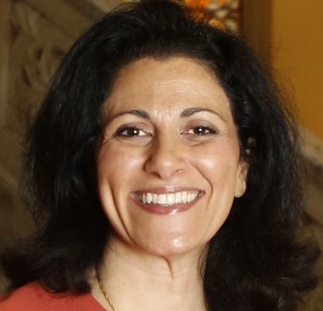
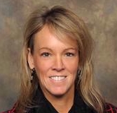
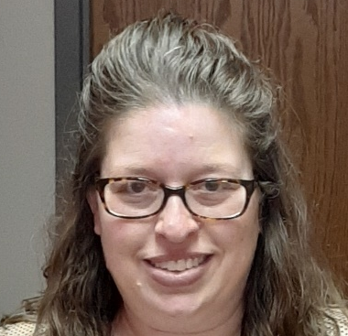
The COM CAR Summer Speaker Series
Sponsored by Urban Health Pathway of Next Lives Here
Thank you to the Planning Committee:
Dena Cranley
Kelly Lyle
Jen Rowe

Slide 4
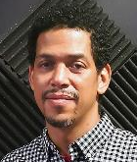
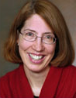
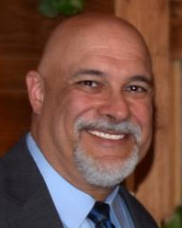
The COM CAR Summer Speaker Series
Special thank you for operational assistance from:
Jermaine Fields – UC IT User Interface and User Experience Developer
Suki Jeffrey - Art Director, UC Academic Health Center Public Relations
Todd Schutter - Multi-Media Coordinator, UC Information Technology

Slide 5
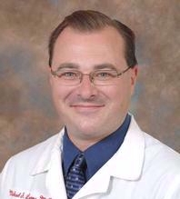
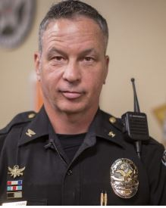
“QRT+”: Role of Academic and Community Partnership in Evolution of Outreach Intervention to Engage Individuals in Treatment for Opioid Use Disorder
Michael Lyons, MD
University of Cincinnati
Col. Thomas W. Synan, Jr.
Chief of Police, Newtown, Ohio

Slide 6
Learning objectives
Consider opportunities to evolve scope and intensity of population health intervention over time
Understand potential for community and practice innovation apart from academic health centers, using example of Quick Response Team (QRT)
Consider the potential for bi-directional learning and synergy when academic health centers and community organizations collaborate

Slide 7
Col. Thomas W. Synan, Jr.
Chief of Police, Newtown, Ohio

Slide 8

When We Formed
Started in March 2015 after what we thought was an “epidemic” with an average of 20-25 overdoes along with 1-2 deaths a week
Now we average 50-75 overdoses with 4-5 deaths per week
At times, we have had over 70 overdoses in a weekend and almost 200 in ONE week

Slide 9
HC ARC Partners: It Takes A Community
Law Enforcement
Fire/EMC
Board of Health
Elected Officials
Mental Health & Addiction Services
Treatment
Hospitals
Prevention First
Interact for Health
Community Groups
Ohio Attorney General Office
US Senator’s Office/White House/ONDCP
All working together to help reduce the impact of addiction

Slide 10
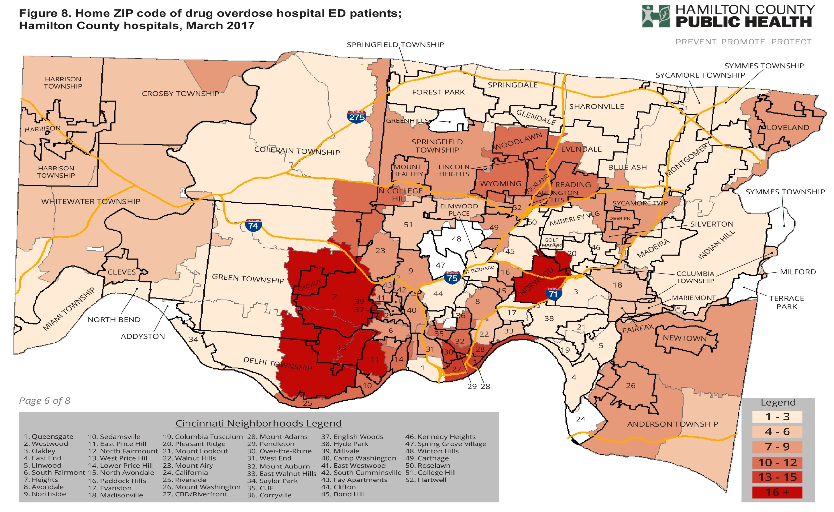

Slide 11
HEALing Communities Study (HCS)
  Drug Alcohol Depend. 2020 Dec 1; 217: 108335.

Slide 12
HEALing Communities Study (HCS)

Slide 13
HEALing Communities Study (HCS)
Test the impact of Communities That HEAL (CTH) intervention
  Community Level: community-engaged intervention with comprehensive, data-driven community response plan (community coalitions)
  Service Organization Level: deploy evidence-based practices (EBPs) across multiple sectors to reduce opioid overdose deaths and associated outcomes

Slide 14
HEALing Communities Study (HCS)
Test the impact of Communities That HEAL (CTH) intervention
  Community Level: community-engaged intervention with comprehensive, data-driven community response plan (community coalitions)
  Service Organization Level: deploy evidence-based practices (EBPs) across multiple sectors to reduce opioid overdose deaths and associated outcomes

Slide 15

CTH Intervention
Opioid-overdose Reduction Continuum of Care (ORCCA)
Community Engagement
Communication Campaign
Opioid-overdose Reduction Continuum of Care (ORCCA)
Identify and engage high-risk populations to expand and enhance:
overdose education and naloxone distribution (OEND)
medication for opioid use disorder (MOUD)
safer opioid prescribing and dispensing

Slide 16
HEALing Communities Study (HCS)
Menu of evidence-based practices
  QRT, screening, linkage to care
Community Need & HCS
  “Operations Team” technical facilitation: what to do & how
  Modest resources: “jump start” and enhance infrastructure
“QRT+”
  Earlier (before the overdose as well as after)
  Longer (not just referral but sustained linkage intervention)

Slide 17
Success Factors for Effective Core Group
Data sharing
Partnership
Hiring the right people
Creation of the operation team

Slide 18
Evidence-Based Action
Core group identifies what the problems are within the bubbles (i.e., prostitution, drug use, theft, etc.)
Core group assigns from subcommittee specific actions
Outreach Responders (Peer Navigators, QRT, LEADS), UC Health, HEALing, Narcan distribution
Response from assignments flows back to the core group which then uses that information to fill in gaps, ultimately building a continuum of care model
Model allows for application to any Hot-Spot in Hamilton County

Slide 19
Q&A
Please unmute to ask a question OR type your question in the chat box.

Slide 20
Thank you for joining us!
Please take a few moments to complete
the survey form. The survey link is provided
in the chat box.
The form is required to complete if requesting CE credit for Social Work or Counseling.

Slide 21
All Summer Speaker Series event recordings can be found by visiting
the CAR website.
Thank you for attending!
https://med.uc.edu/institutes/CAR/speaker-series

