Slide 1
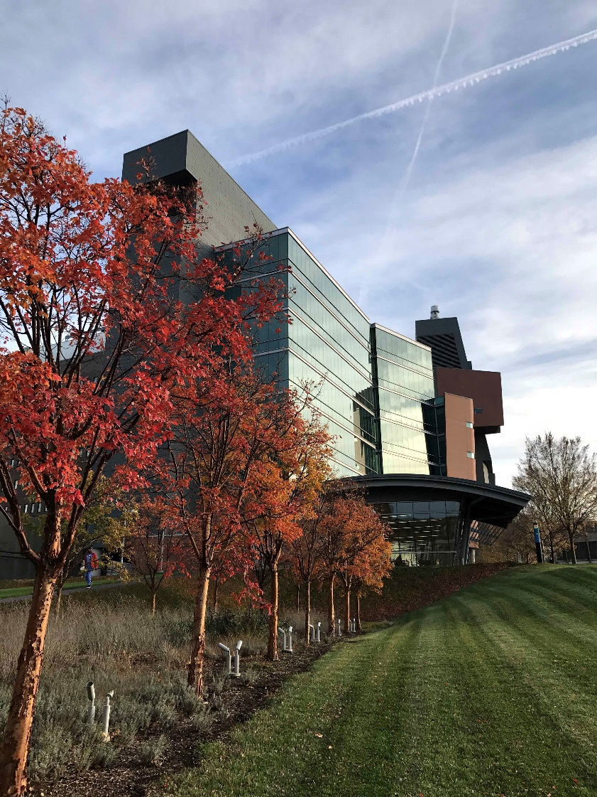
Navigating the NIH
Notes:
September 10, 2026

Slide 2
Brief overview of NIH organization and kinds of grants (activity codes) and key nomenclature
Changes to K awards
New grant types
New review information
NIH staff and their roles and responsibilities
Upcoming changes to LOS
Notes:
Essentially two components: identifying existing grants vs. identifying existing grant opportunities.

Slide 3
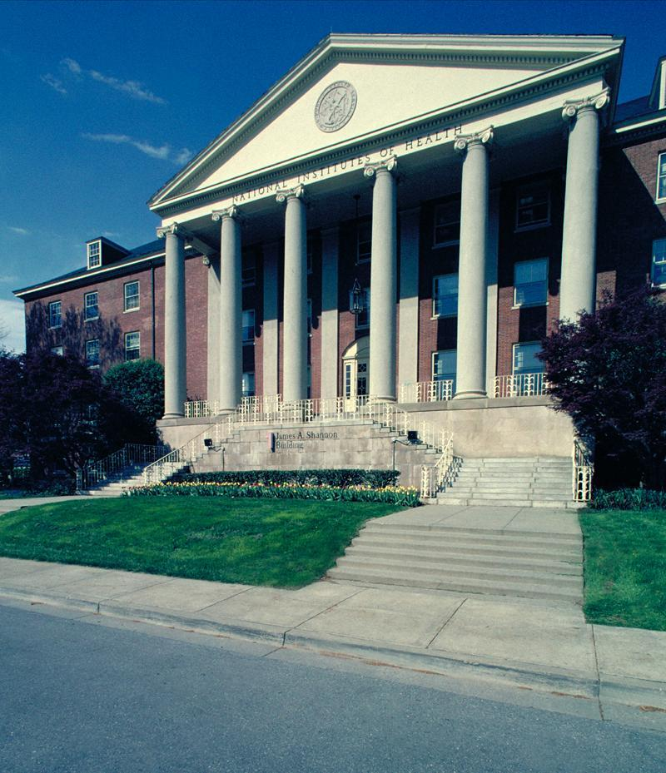























NIH organization
NIH is made up of 27 Institutes and Centers.
Each has a specific research and research training agenda, focusing on particular diseases or body systems
One agency of 11 within U.S. Department of Health and Human Services (HHS)

Slide 4
Most Kinds (activity codes) of NIH Grants
Graduate/ Clinical Training
Postdoctoral Training/Clinical Residency
Early Research Career
Established Investigator
T32, T35
T32
K01, K07, K25
K08, K23
R03, R21, R01
P01, P50 PF5
F32
R25, K12
K22,
K99
K22, R00
F30, F31 F99/K00
K02, K24
Loan Repayment Programs
Re-Entry Supplements

Slide 5
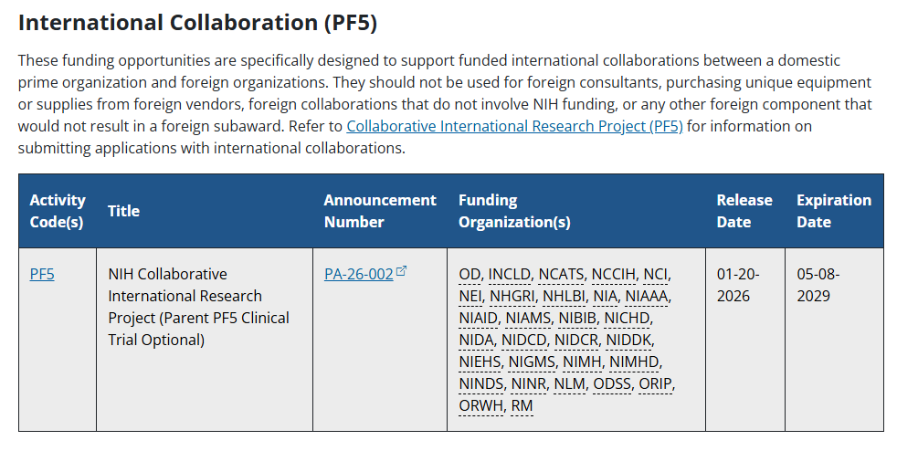

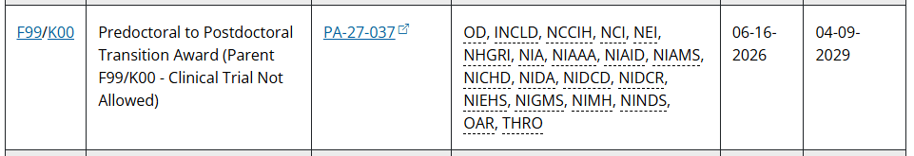
2 New Types of Awards

Slide 6
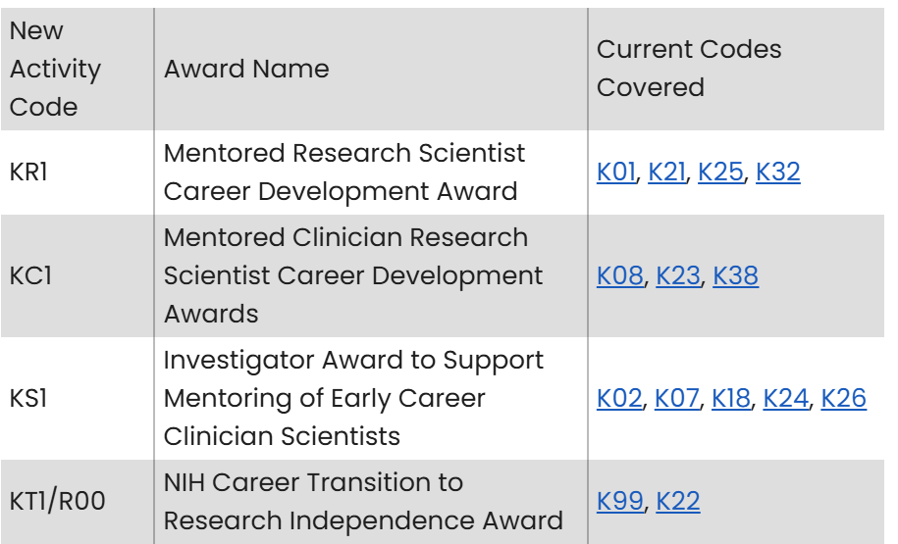
Updates to Career Development (K) Award programs

Slide 7
Updates to Career Development (K) Award programs continued
Activity Codes not affected by these changes
K00 (Postdoctoral Transition)
K43 (International Research Career Development
K12 (Institutional Career Development Awards)
K76 (Emerging Leaders Career Development Award)
**K award applications will no longer require a Data Management and Sharing (DMS) Plan

Slide 8
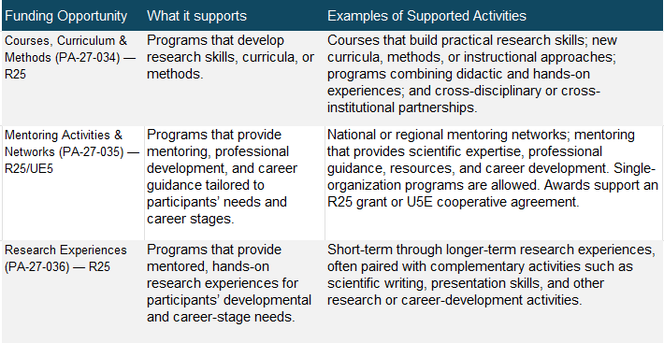
Education, Mentoring, and Research Experiences

Slide 9
Types of
Notices of Funding Opportunity (NOFOs)
Type of NOFO | Description
Program Announcements (PA, PAR, PAS) | Highlights areas of focus Often use standard receipt dates
Requests for Applications (RFA) | Narrowly defined scope Usually single receipt date Set aside funds IC usually convenes review panel
Parent Announcements | Type of program announcement Generally span the breadth of NIH mission By activity code (R01, R03, etc) For “investigator initiated” or “unsolicited” research ideas

Slide 10
Parent Announcements
An NIH-wide FOA enabling applicants to electronically submit investigator-initiated grant application for a specific activity code, e.g., Research Project Grant (Parent R01).
(ICs may not participate in all Parent Announcements)
Most of the applications researchers submit fall into this category of Unsolicited, Investigator-Initiated Research directed in response to program announcements (PAs) Investigator-initiated means you create an application in any area of science NIH supports.
List of all Parent Announcements:
(https://grants.nih.gov/grants/guide/parent_announcements.htm)

Slide 11
Advantages of Investigator-Initiated Applications
Leeway to generate your own ideas
Center your research within your own interests and expertise.
You can also control when you apply. (Most program announcements (PAs) have multiple receipt dates, so you have more flexibility to apply when it's best for you.)

Slide 12
Highlighted Topics vs. NOFOs
Highlighted Topics vs. NOFOs
Highlighted Topics are a communication tool to promote a particular area of science within the NIH mission and encourage investigator-initiated applications from the community. They provide quick, simple information that is specific to the research topic area.
In contrast to NOFOs, Highlighted Topics
  Give the applicant more freedom and creativity in responding to a topic
  Are less prescriptive than a science-specific NOFO
  Do not direct the applicant to use a particular NOFO, a particular due date or budget, or set other eligibility or application criteria
  Provide topic inspiration. Applicants use an appropriate funding opportunity, such as one of the NIH Parent Funding Announcements or other broad NIH opportunities on Grants.gov
  Are not funding opportunities
  NIH may or may not have dedicated funding for applications in any given topic area
  Do not impact referral or peer review of applications
  Expire after 1 year. However, NIH may choose to update or renew a topic.
FAQs: https://grants.nih.gov/faqs#/highlighted-topics.htm?anchor=57794

Slide 13
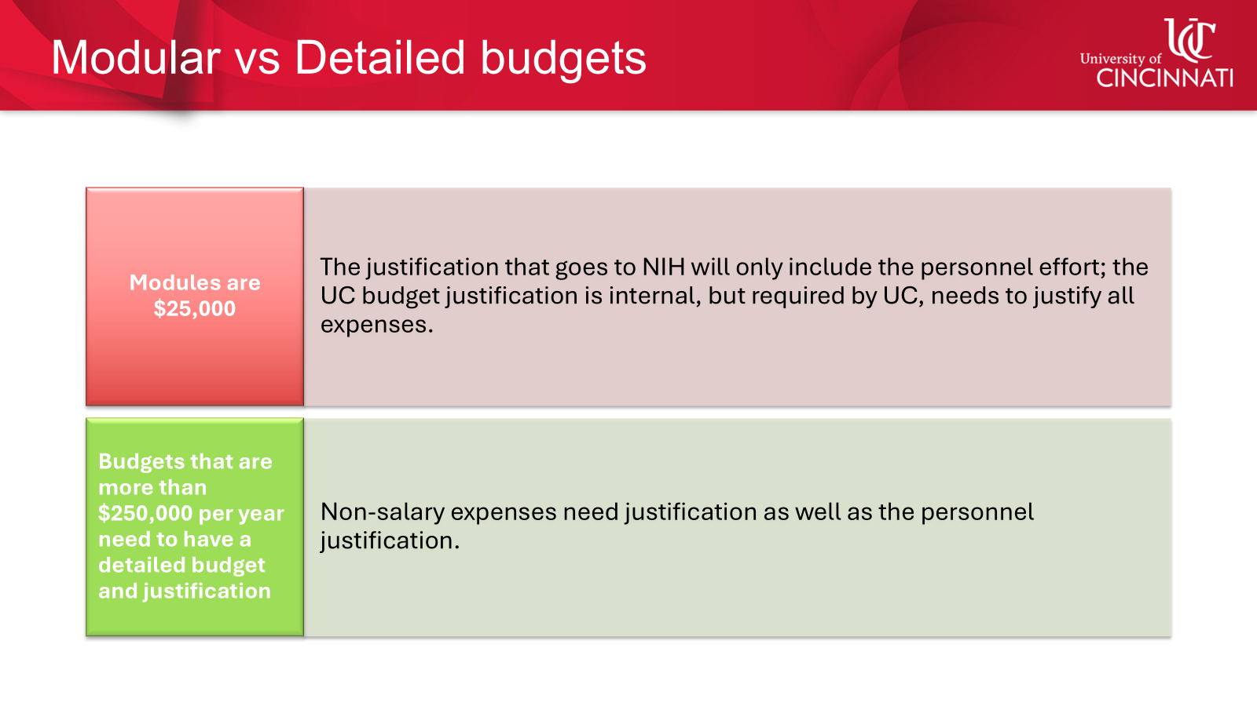
Effective immediately, NIH will no longer require applicants requesting $500,000 or more in direct costs (excluding consortium F&A costs) in any one budget period to contact the funding Institute or Center (IC) before application submission. In line with this change, applicants are no longer required to include a cover letter identifying the Program Official contact which notes that the IC has agreed to accept assignment of the application.

Slide 14

Contacting NIH Staff
When to Contact | PO | SRO | GS
Before Application Submission to discuss: Research idea (or specific aims) & fit with IC/priorities Grant programs and funding opportunities Questions about application process
After Submission/Before Peer Review to discuss: Review assignment or concerns (e.g., panel expertise) Request to send additional/corrective materials
After Peer Review to discuss: Summary statement and response to reviewer critiques Potential for application resubmission
At any point to discuss: Budget questions/administrative issues about award Interpretation of grants policies
PO=Program Officer; SRO=Scientific Review Officer; GS=Grants Specialist

Slide 15
Program Officer
Responsibilities
Develop research and research training initiatives.
Write notices of funding opportunities (NOFOs).
Provide scientific guidance to investigators pre- and post-award.
Monitor the programmatic, scientific, and/or technical aspects of a grant.
Work in partnership with grants management staff on post-award administration, including review of progress reports.
When to Contact
To help identify an appropriate type of grant program and/or funding opportunity for you and your research​.
To obtain input on whether your specific aims fit within the mission and priorities of an NIH institute or center.
To discuss whether your research is considered a clinical trial.
To discuss the outcome of review after receiving and reviewing your summary statement.
To talk about progress or scientific and administrative issues that arise with the grant post-award.

Slide 16
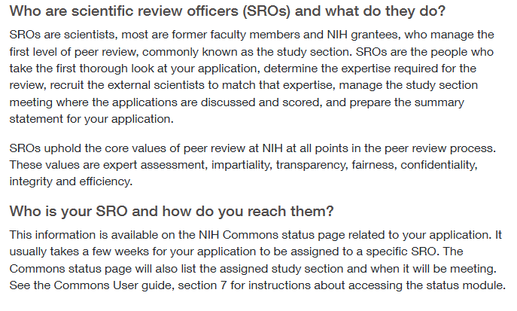
Scientific Review Officer

Slide 17
Grants Management Specialist
An NIH Grants Management Specialist (GMS) is a federal staff member who handles the business, financial, and non-programmatic administration of research grants and cooperative agreements.
Key Responsibilities
Budget Review: Evaluate grant application budgets for cost reasonableness, allowability, and compliance with federal statutes and the NIH Grants Policy Statement.
Negotiation & Award: Negotiate award terms, obligate funds, and officially issue notices of award on behalf of the National Institutes of Health (NIH).
Post-Award Oversight: Monitor ongoing financial compliance, review annual progress reports in partnership with Program Officers, and manage closeout procedures.
Technical Assistance: Provide guidance to grantee institutions regarding administrative rules, prior approvals, and fiscal management.

Slide 18
NIH Forms J updates
With the implementation of Forms J in Fiscal Year 2027, the NIH will no longer allow letters of support but will instead require letters of collaboration to document any collaborative relationships with individuals that are not identified in the application as senior/key personnel or other significant contributors.
Letters designed to endorse the application without an intent to collaborate or provide material support will no longer be permitted in NIH grant applications.
Letters of collaboration should be limited to stating the intent to collaborate or provide material support.
An individual letter of collaboration must not exceed 100 words. NIH encourages applicants to use the following single-sentence format for letters of collaboration. "If the application submitted by [Organization Name and with PD/PI Name] as Program Director/Principal Investigator entitled [Grant Application Title] is selected for funding by NIH, it is my intent to collaborate and/or commit resources as detailed in the application."

Slide 19
NIH links
Be sure to check nih.gov frequently to stay up to date on new policies, etc.
Https://www.nih.gov/web-modernization
https://grants.nih.gov/policy-and-compliance

Slide 20
NCI updates
NCI – is not funding many R21s or R03s
If U01 or R01 is between $175K - $250K will get an 8.5% cut to the budget
If it is greater than $250K, there will be a 17% cut to the budget
Animal research – need to have a brief explicit justification of why an alternative is inferior- this needs to be in the abstract. Proposals should contain a plan for validation of finding in the animal studies in a human model.

Slide 21
NIH Scoring process
Last November, NIH implemented emergency modifications to review processes following resumption of activities after the lapse in appropriations.
One modification was reducing the discussion rate from approximately 50% of applications to approximately 33%. Recognizing that strong applications may fall below a 33% cut off, the middle third of applications in a study section were designated as “competitive but not discussed.” These applications:
Were not discussed at the review meeting
Will not have a resume of discussion when the summary statement is released (but will include written critiques from the three assigned reviewers)
Will not have a priority score
Could be recommended to NIH Institute/Center Director for funding by their program staff
The Competitive, Not Discussed designation can be found at the top of page 1 of the summary statement

Slide 22
NIH Scoring process con’t
To enable NIH to continue high quality and timely peer review of NIH grant applications, the following modifications will remain in place for the January 2027 Advisory Council:
The percent of applications discussed in most meetings will be reduced to 30-35%, instead of the usual ~50%.
Applications voted by the committee to be in the middle third will be designated as "competitive but not discussed" and applications in the lowest third will be designated as "not competitive and not discussed". Applications in the middle third will be considered for funding, along with the discussed applications.
Summary statements will be simplified. Narrative paragraphs summarizing committee discussion will not be used. Instead, summaries will have a sentence describing the degree of consensus in the committee vote, plus bullets listing the main score driving points. Summaries for all applications will contain the written critiques from the 3 assigned reviewers, as is currently the case. Summaries for applications that are discussed will have the overall impact score.

Slide 23
NIH Scoring process con’t
Take Away
Applications in the middle were not overlooked. Rather, these applications were judged to have scientific and technical merit and may be considered for funding, even though they were not discussed or scored. Program staff may recommend these applications for funding to their Institute/Center Director, particularly when considering programmatic priority, portfolio balance, or available funds (in alignment with the NIH Unified Funding Strategy).
What should applicants do next?
Applicants should carefully review their summary statements resulting from the study section meeting.
You can consider discussing your summary statement with appropriate program staff, including:
Funding likelihood in that Institute/Center
Whether a resubmission is advisable
Please remember to keep in mind what the program officials roles are (and are not) before seeking their advice.

Slide 24
How to access ARS services
To initiate support services, contact:
Teresa Larkin at larkint@ucmail.uc.edu
Suzanne Morris at morrissc@ucmail.uc.edu
Lisa Bilinsky at bilinsll@ucmail.uc.edu
Office Location: MSB 6053
  Arrange a meeting, (meeting in person or over Teams) to discuss your request
.

Slide 25
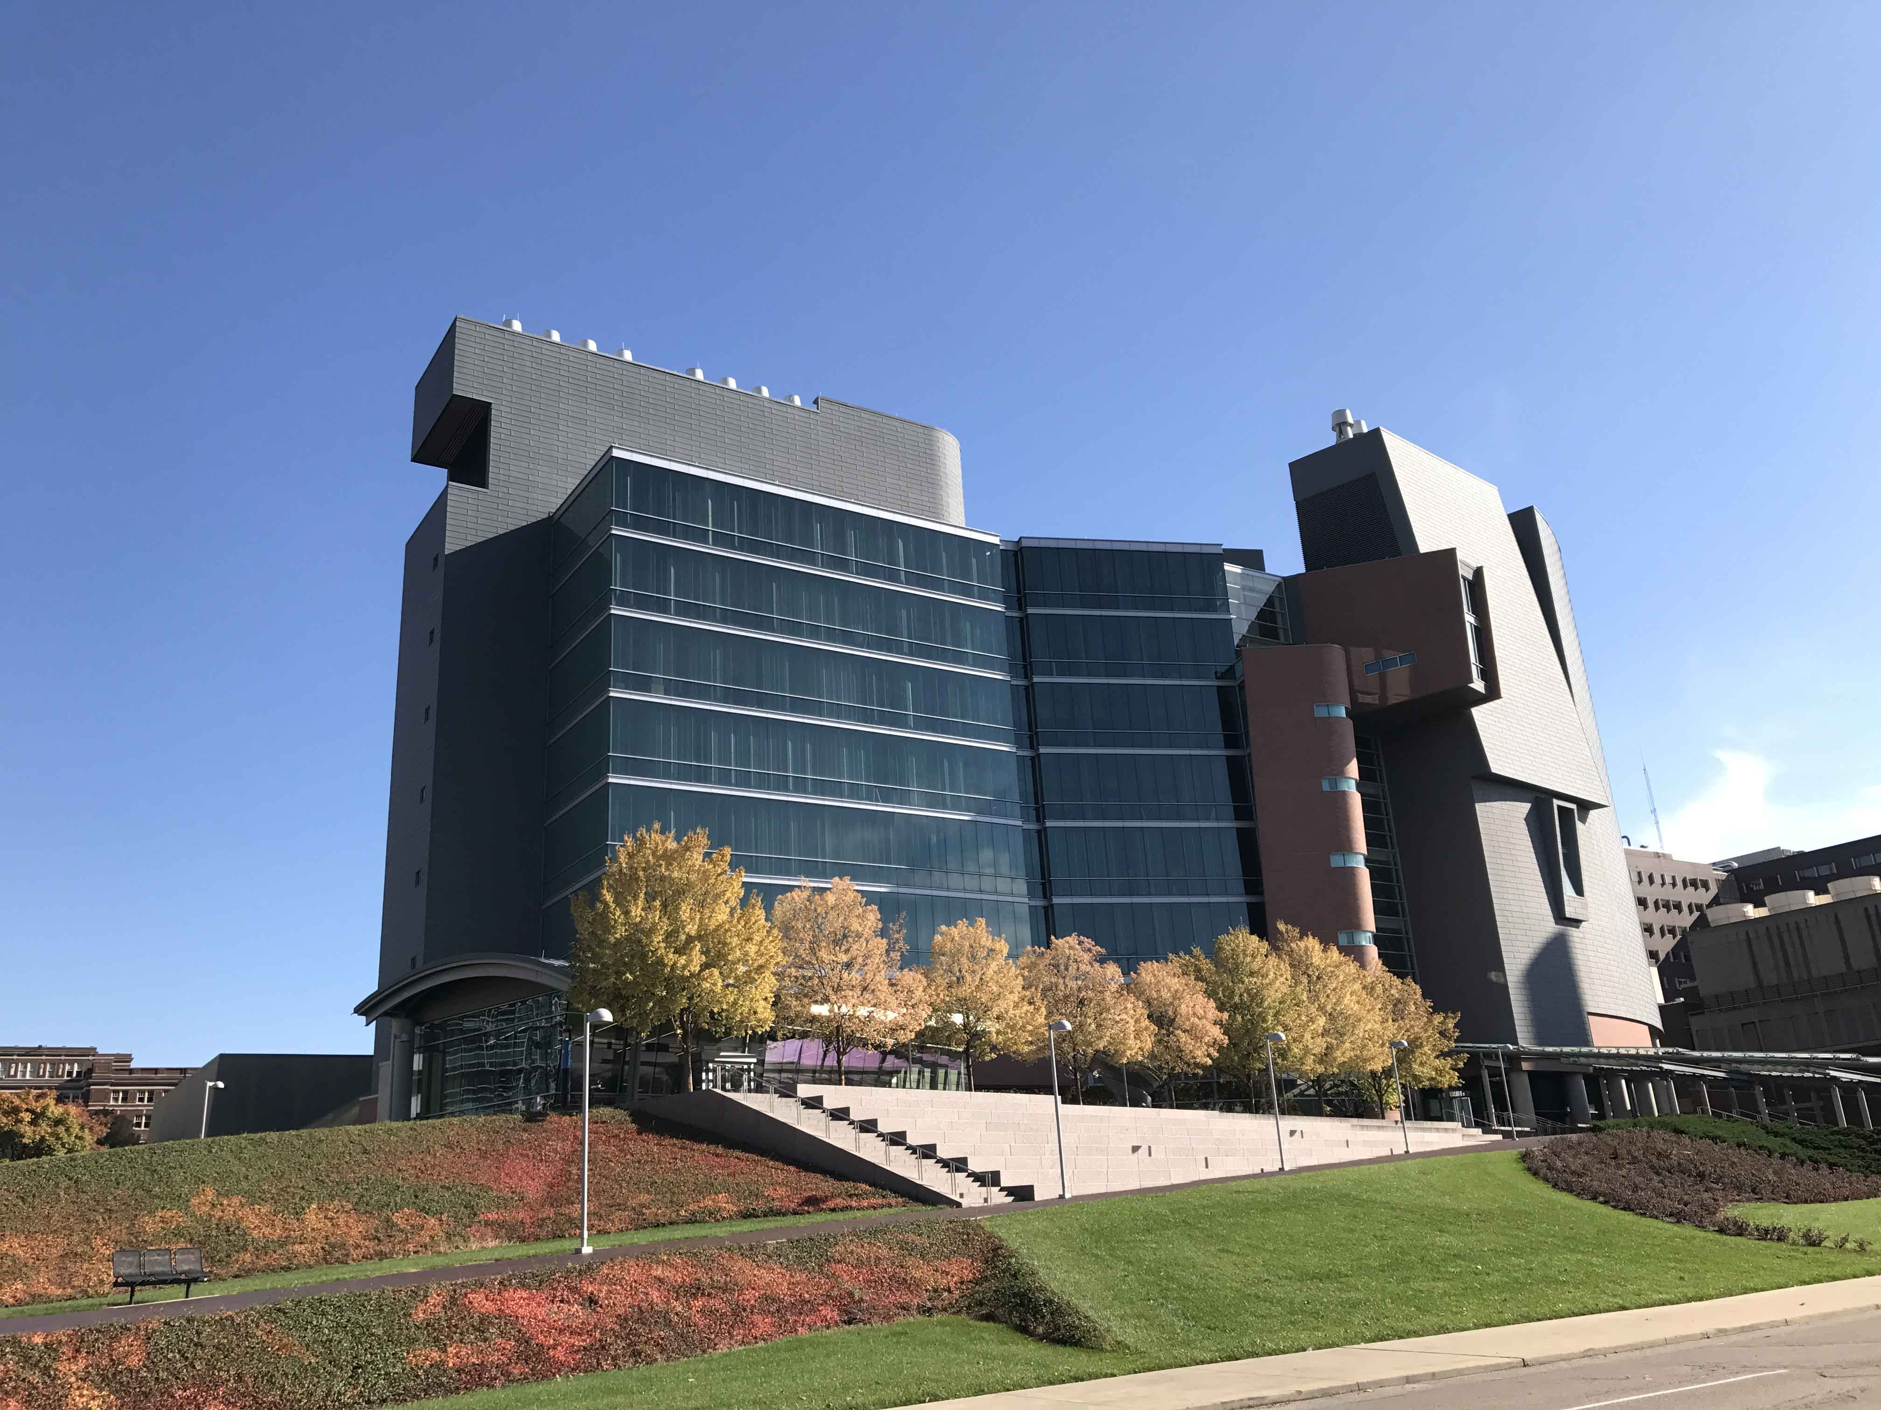
Thank you - ARS looks forward to assisting you with your grant applications.

