Slide 1
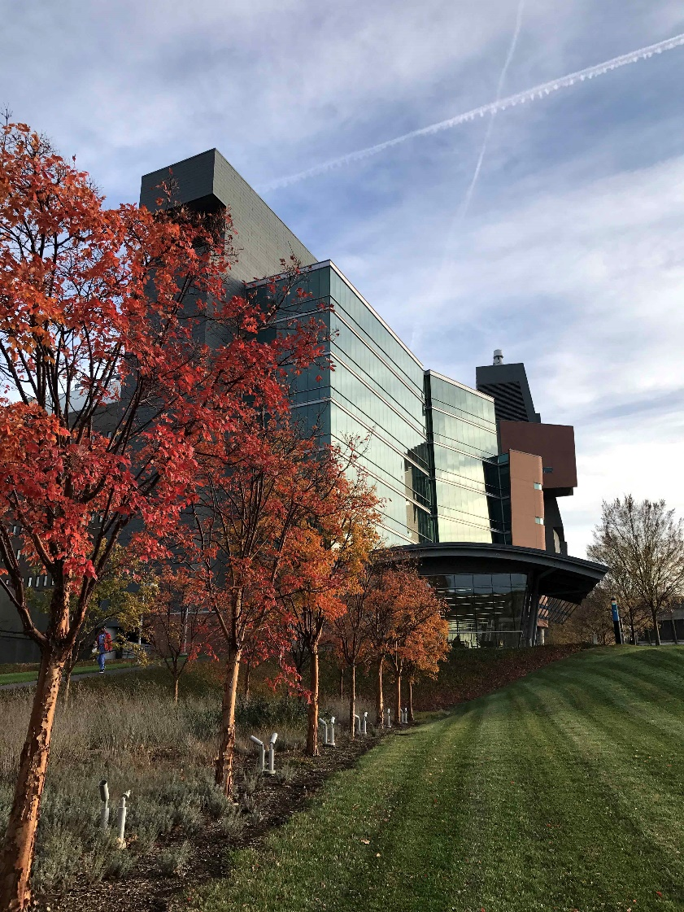
Finding and Understanding NIH Funding Opportunity Announcements

Slide 2
Brief overview of NIH organization and kinds of grants (activity codes) and key nomenclature
How to search funded grants
  Research Portfolio Online Report Tool (RePORT) (https://www.report.nih.gov/)
How to find funding opportunity announcements (FOA) of interest
Notes:
Essentially two components: identifying existing grants vs. identifying existing grant opportunities.

Slide 3
























NIH organization
NIH is made up of 27 Institutes and Centers.
Each has a specific research and research training agenda, focusing on particular diseases or body systems
One agency of 11 within U.S. Department of Health and Human Services (HHS)

Slide 4
Most Kinds (activity codes) of NIH Grants
Graduate/ Clinical Training
Postdoctoral Training/Clinical Residency
Early Research Career
Established Investigator
T32, T35
T32
K01, K07, K25
K08, K23
R03, R21, R01
P01, P50
F32
R25, K12
K22,
K99
K22, R00
F30, F31
K02, K24
Loan Repayment Programs
Re-Entry Supplements

Slide 5
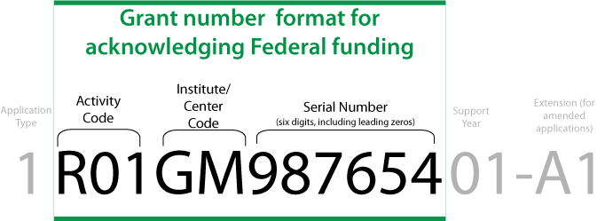
Institute/Center (IC)
Codet
CA: NCI
Support
Year
Application
Type=
5 RO1 CA095286 - 12
Activity
Code
Serial
Number
(Six digits including
leading zeros)

Slide 6
APPLICATION TYPES
Number | Stage | Description
1 | New | Initial request
2 | Renewal | Initial request for addition funding/competitive
3 | Competing revision | Initial request for (or the award of) additional funds during a current project period to support new or additional activities that are not identified in the current award.
4 | Change of Organization | Transfer of all of the assets of the grantee
5 | Noncompeting continuation | Progress report non competitive

Slide 7
T32: pre/post doctoral institutional training grant
T35: short-term research training (often during summer)
F30: fellowship program (predoctoral leading to combined MD/PhD)
F31: fellowship program (predoctoral leading to a PhD)
F32: fellowship program (postdoctoral)
P01: research program project (broadly based/multidisciplinary)
P50: specialized center
U01: research project – cooperative agreement
UG3/UH3: Phase 1/2 exploratory/developmental cooperative agreements

Slide 8
K01: research scientist development award – research & training
K02: research scientist development award – research (for more established investigator)
K07: academic teacher award
K08: clinical investigator award (CIA)
K12: physician scientist award program (sponsored by institution)
K22: career transition award (intramural NIH to extramural)
K23: mentored patient-oriented research career developmental award
K24: midcareer investigator award in patient-oriented research
K25: mentored quantitative research career development award
K99/R00: career transition award

Slide 9
R01: research project (primary PI(s) dedicated to discrete project)
R03: small research project grant
R13: conference
R15: educational institutions not major recipients of NIH support
R21: exploratory/developmental grants Phase 1
R33: exploratory/developmental grant Phase II
R25: educational project
R34: planning grant (frequently for a clinical trial)
R35: outstanding investigator award
R37: MERIT award (method to extend research in time)
R38: mentored research pathway in residency
R41/42/43/44: small business technology transfer grants

Slide 10
Why search funded grants, etc.?

Slide 11
Projects similar to yours
Potential collaborators
Study section that is likely to review your application
Institute/center that funds research like yours
Type of mechanism (e.g., RO1, R21, etc.)
Success rates
Award trends
Organizational funding information
Resources are currently invested in your area
NIH staff contacts

Slide 12

https://report.nih.gov/
(Research Portfolio Online Reporting Tools (RePORT)

Slide 13
Research Portfolio Online Reporting Tool (RePORT)
A searchable database of federally supported biomedical research
Access reports, data, analyses, expenditures, results of NIH supported research activities
Identify, analyze IC research portfolios, funding patterns, funded investigators:
    Identify areas with many or few funded projects
    Identify NIH-funded investigators and their research
    Identify potential mentors/collaborators

Slide 14
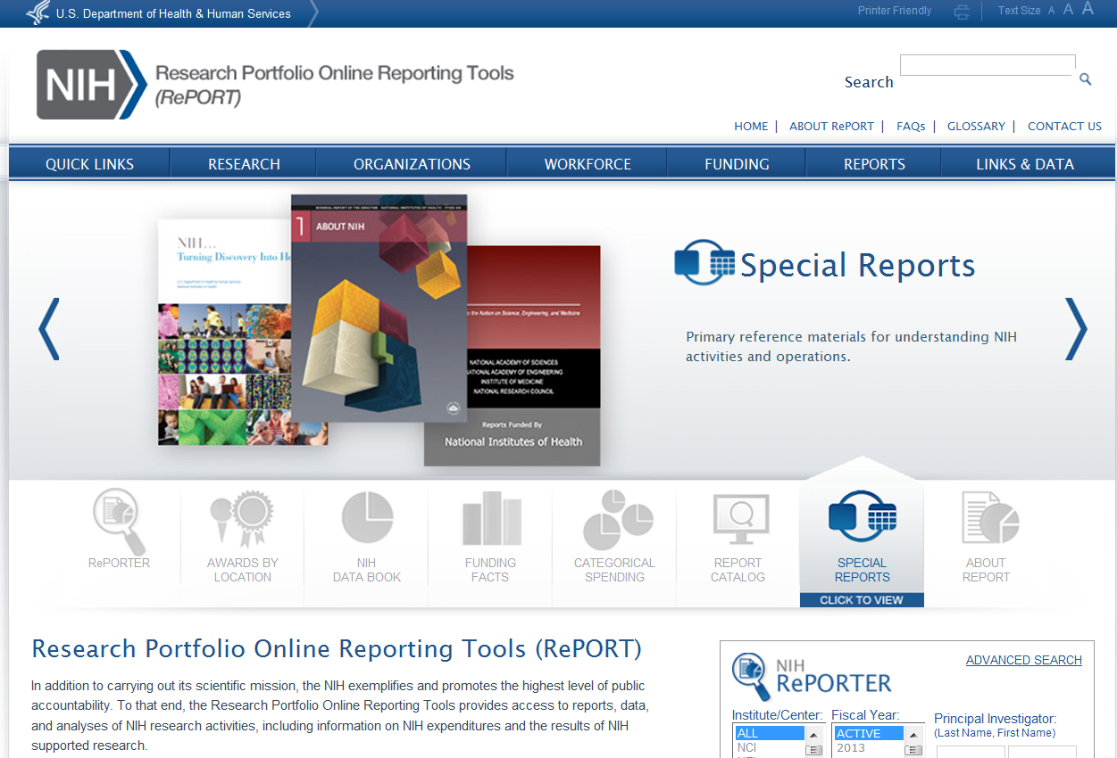
Start general…then more specific:
Example: Cancer https://report.nih.gov/

Slide 15
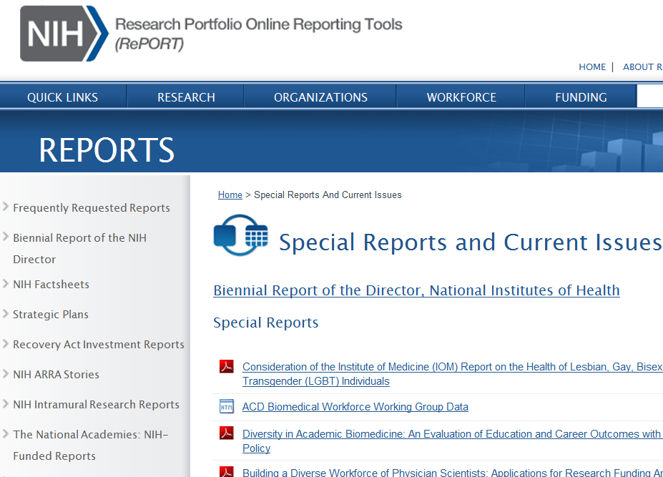

Slide 16
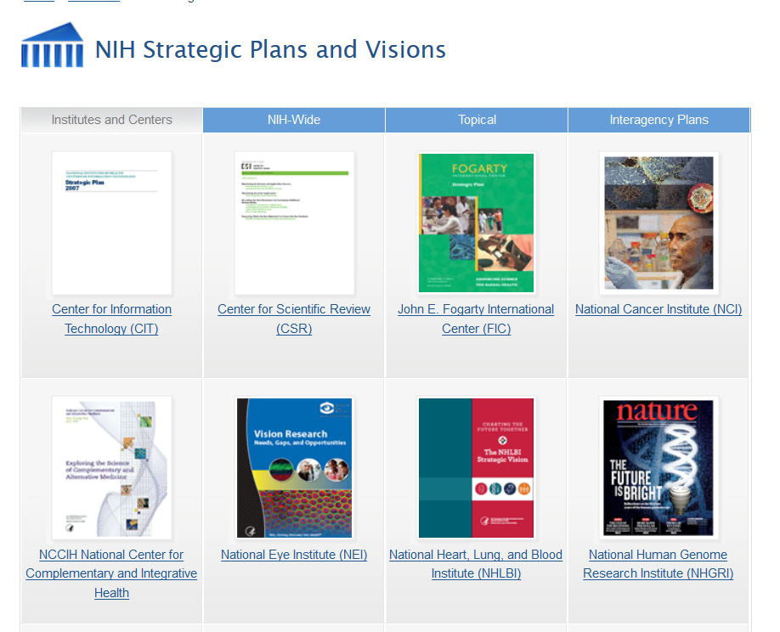

Slide 17

Who and what NIH funds on this topic?

Slide 18
Data & Visualize
    Circles
    Summary by…….
Map
Sort by State
Publications
Clinical Studies
News & More
Example: OHIO, UC, institutional training grants

Slide 19
Matchmaker
  IC
  Activity Code
  Study Section
  Match scores
2. Individual Projects
  Description
  Details
    PI, NIH program officer, FOA, review panel
  Similar and nearby projects

Slide 20
Federal Reporter
http://federalreporter.nih.gov/
Trans-federal agency searchable database of science awards
https://worldreport.nih.gov/app/#!/

Slide 21
Funding Opportunities
(as they relate to your career stage, in particular)
  Grants.gov (https://www.grants.gov/) . (Grants.gov is the federal-wide portal for advertising funding opportunities that is used by all federal grant-making agencies.)

Slide 22
What stage are you in your career?
Are you a New or Early Stage Investigator?
  (http://grants.nih.gov/grants/new_investigators/index.htm)
What the grants that you are eligible for based on your career stage?

Slide 23

Research Projects
Small Business
Training & Career Development
Research Centers
Identify Right Type of Grant for Your Idea (and you)?

Slide 24
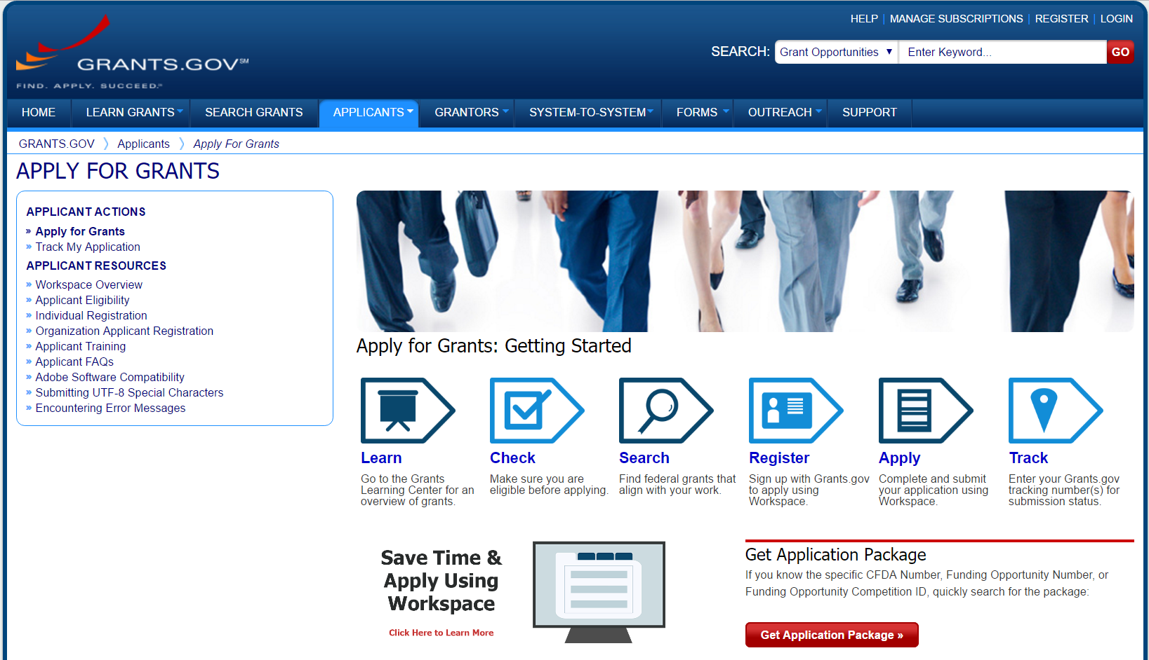
https://www.grants.gov/

Slide 25
Types of
Notices of Funding Opportunity (NOFOs)
Type of FOA | Description
Program Announcements (PA, PAR, PAS) | Highlights areas of focus Often use standard receipt dates
Requests for Applications (RFA) | Narrowly defined scope Usually single receipt date Set aside funds IC usually convenes review panel
Parent Announcements | Type of program announcement Generally span the breadth of NIH mission By activity code (R01, R03, etc) For “investigator initiated” or “unsolicited” research ideas

Slide 26
Parent Announcements
An NIH-wide FOA enabling applicants to electronically submit investigator-initiated grant application for a specific activity code, e.g., Research Project Grant (Parent R01).
(ICs may not participate in all Parent Announcements)
Most of the applications researchers submit fall into this category of Unsolicited, Investigator-Initiated Research directed in response to program announcements (PAs) Investigator-initiated means you create an application in any area of science NIH supports.
List of all Parent Announcements:
(https://grants.nih.gov/grants/guide/parent_announcements.htm)

Slide 27
Investigator-Initiated Research
• Program Announcements (PA)
• Unsolicited from general
institute extramural budget
• R01, R21, R03
• ~ 80% of awards

Slide 28
Advantages of Investigator-Initiated Applications
Leeway to generate your own ideas
Center your research within your own interests and expertise.
You can also control when you apply. (Most program announcements (PAs) have multiple receipt dates, so you have more flexibility to apply when it's best for you.)

Slide 29
Request for Applications (RFA)
• Solicited; set-aside of funds for a certain number of awards
• One-time competition to stimulate research in a priority area
• R01, R21, R03, P01, Cooperative Agreement
• If an RFA submission is not successful, a subsequent application should be submitted as a new application, not a resubmission
• ~ 10% of awards

Slide 30
Having developed an initial compelling idea with the necessary passion and skills to pursue it, and you have:
Familiarized yourself with the NIH organization
Defined your career stage and eligibility
Become knowledgeable regarding the nomenclature, types of grants, etc.
Use RePORT to survey the existing grants, Institutes related to your research, resources being applied to your area of research.
Consult with your colleagues and mentors
Screen for available FOAs though grants.gov, NIH guide for contracts and grants, various available funding alerts mechanism (SPIN, GrantForward)

Slide 31
THE NEXT IS:
  Contact NIH program staff early
  Ask what information would help them advise you about IC interest & “goodness of fit”
  Are there related FOAs?

Slide 32

Contacting NIH Staff
When to Contact | PO | SRO | GS
Before Application Submission to discuss: Research idea (or specific aims) & fit with IC/priorities Grant programs and funding opportunities Questions about application process
After Submission/Before Peer Review to discuss: Review assignment or concerns (e.g., panel expertise) Request to send additional/corrective materials
After Peer Review to discuss: Summary statement and response to reviewer critiques Potential for application resubmission
At any point to discuss: Budget questions/administrative issues about award Interpretation of grants policies
PO=Program Officer; SRO=Scientific Review Officer; GS=Grants Specialist

Slide 33
Program Officer
Responsible for the programmatic, scientific, and/or technical aspects of a grant
Provides scientific guidance to investigators pre- and post-award
Develops initiatives
Provides post-award oversight

Slide 34
How to access ARS services
To initiate support services, contact Teresa Larkin at larkint@uc.edu (513-558-3519), Suzanne Morris at morrissc@ucmail.uc.edu (513-558-5721), or Lisa Bilinsky at bilinsll@ucmail.uc.edu
Office Location: MSB 6053
  Arrange a meeting, (meeting by phone or over Teams) to discuss your request
  A determination will be made if the Academic Research Services (ARS) team can meet the needs within time constraints.
.

Slide 35
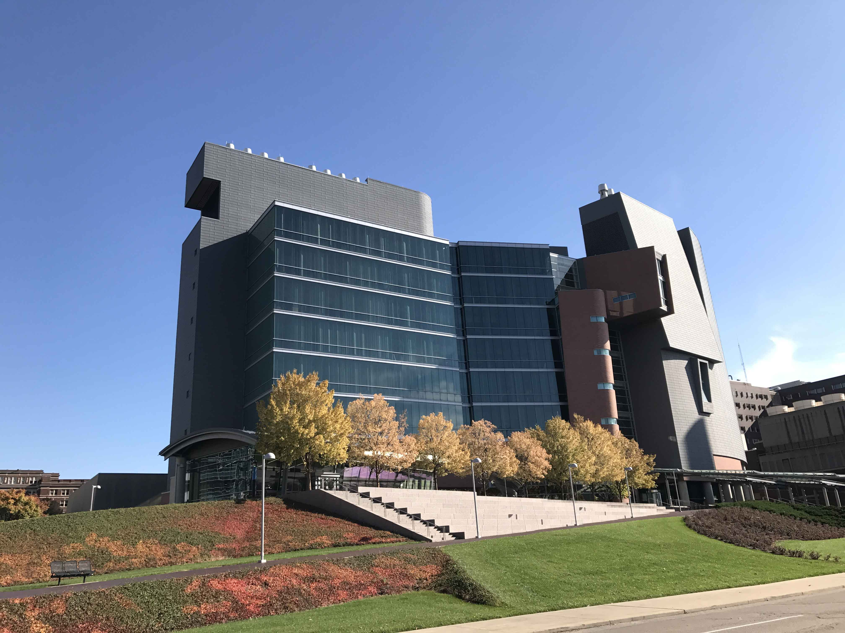
Thank you - ARS looks forward to assisting you with your grant applications.

